Slide 1
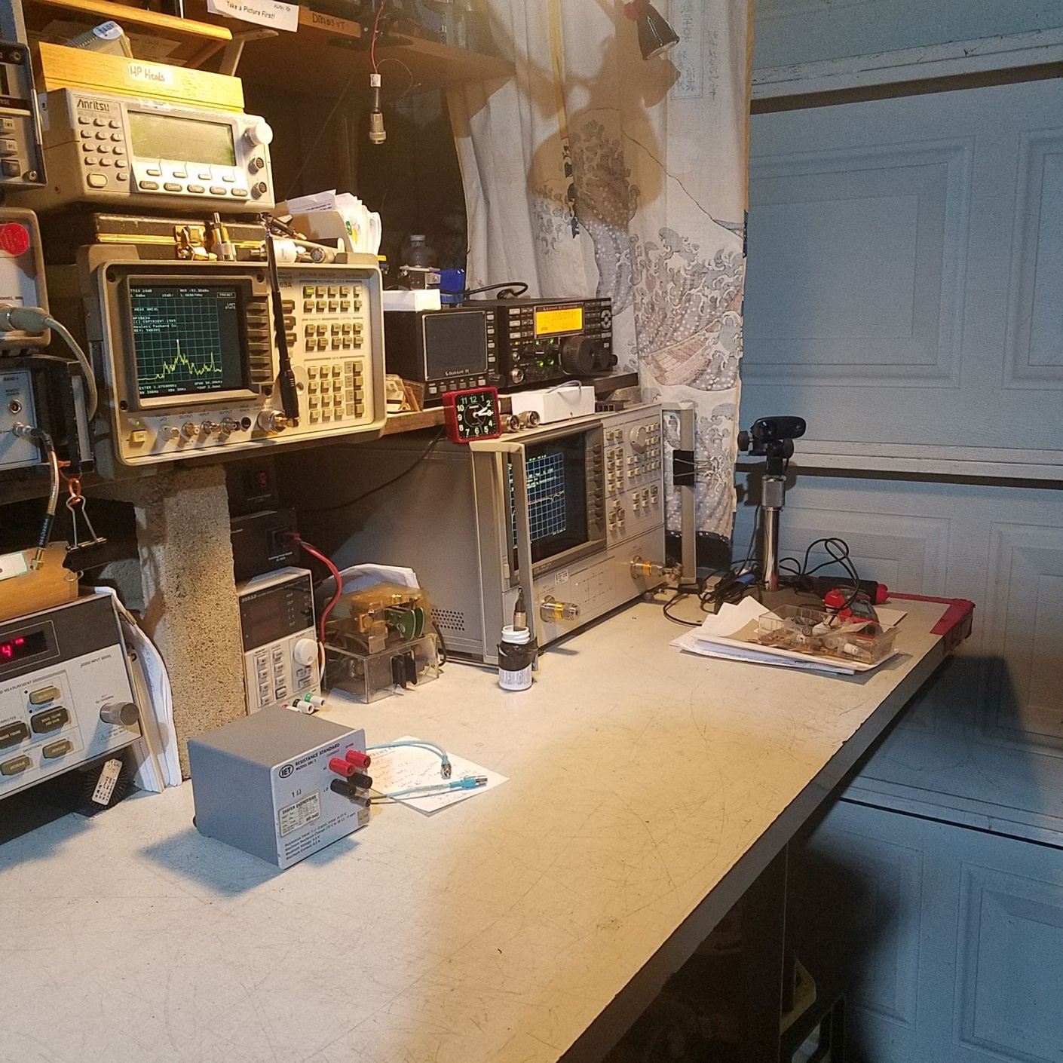
JEY Labs Presents
Test Gear
For
Hams
Doug Millar
K6JEY

Slide 2
Modern Choices on a Budget
Doug Millar K6JEY

Slide 3
Planning
Which gear do you use the most?
What will you need in the future?
Will you want to keep or get any favorites?

Slide 4
MULTIMETERS

Slide 5
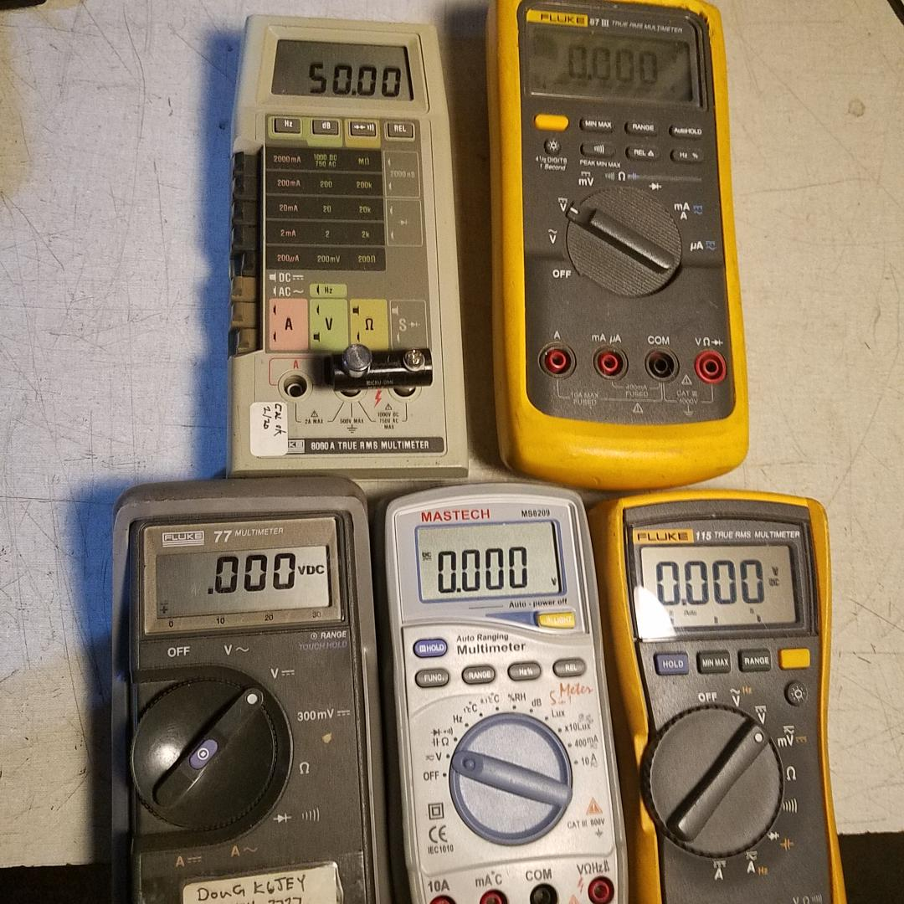
They all read correctly with 50ohms
Fluke
8060a
(1977)
87iii
(2000)
Fluke 77
(1980)
Mastech 8906
(1999)
Fluke 115
(2010)

Slide 6
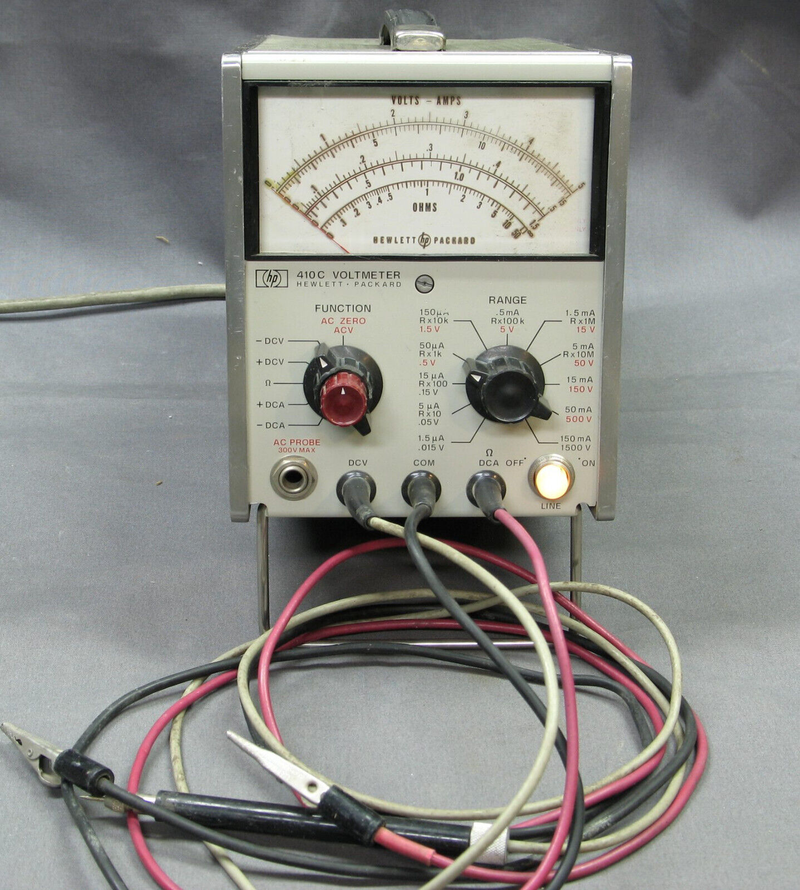
You Can Keep an old Friend
But-
You get Tired of-
Too many
leads
switches
scales
Zeroings
Warm up time
It is still a good
RF voltmeter.

Slide 7
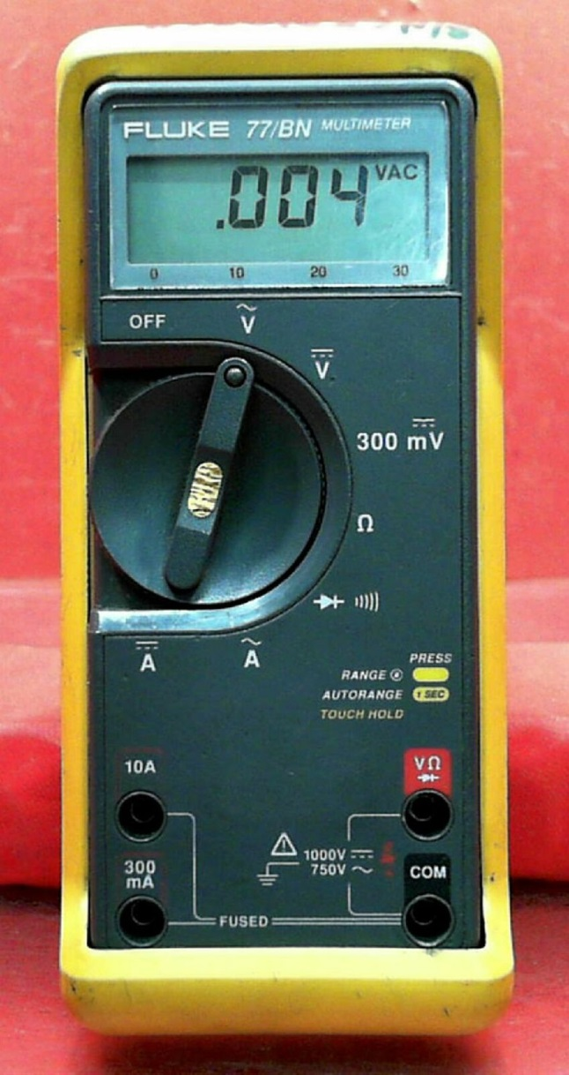
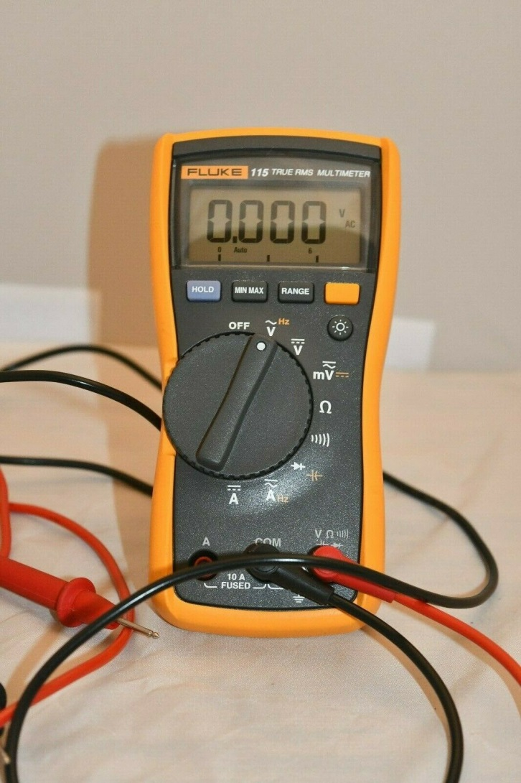
Fluke 115 and 77
Zeros fast, auto ranging and tough
True RMS
One handed
About $110
$50

Slide 8

ANENG 681
Color model available
Form factor of phone
USB charging
Excellent display
Auto function
Well built and sturdy
$26 Best Bang/$

Slide 9
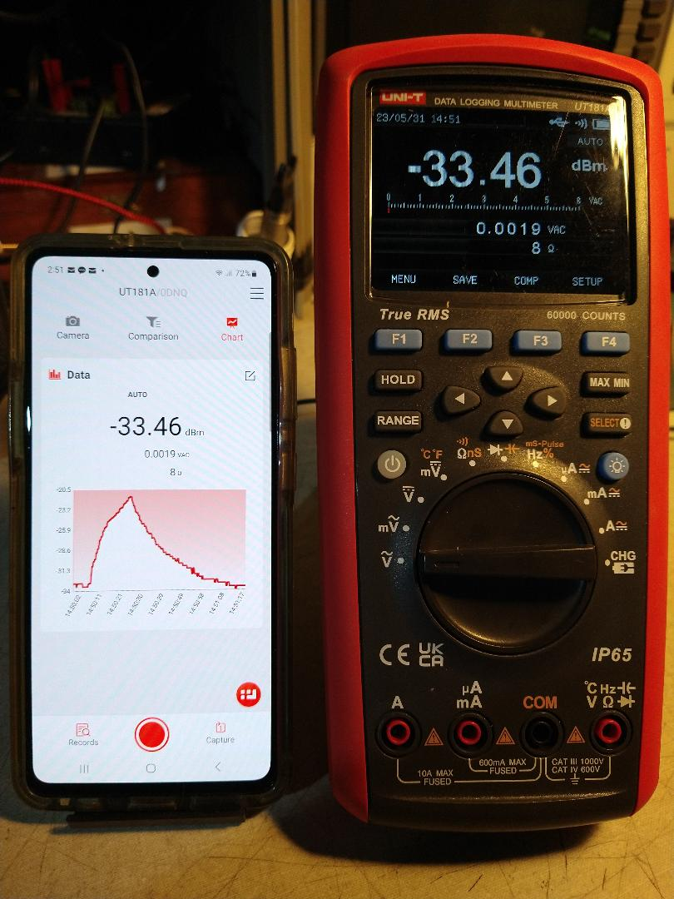
UT 181A
DMM with Android APP
via Bluetooth..
Does remote data
collection.
About $290
Also a cheaper model
UT61E+ at $90
But no internal data logging
Or DBm measurement.

Slide 10
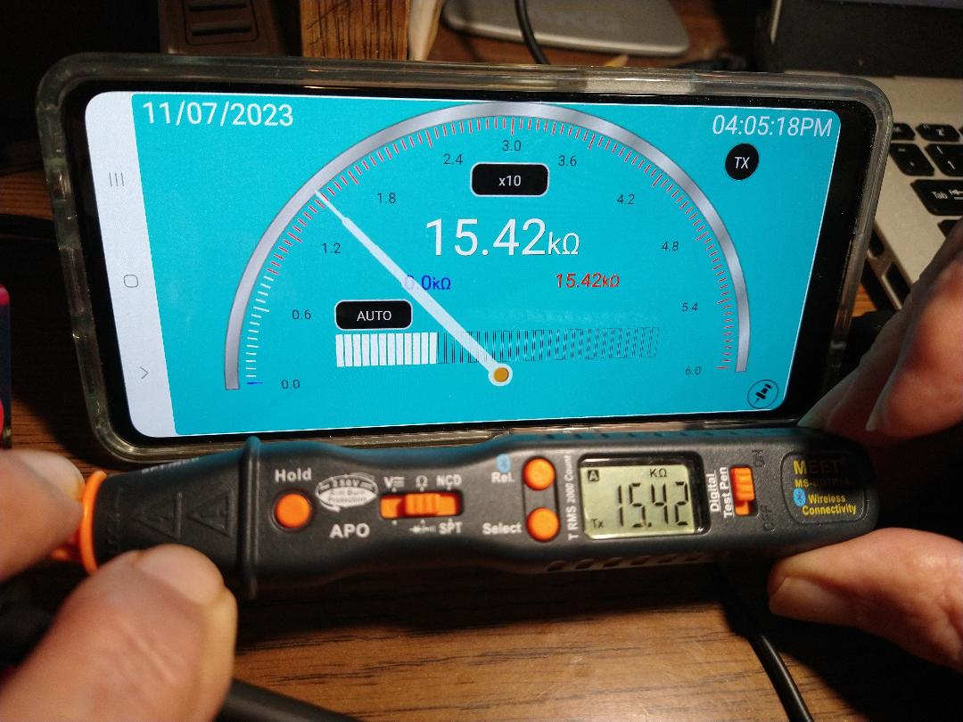
Meet Pencil DMM
Turn the phone
clockwise for this display
Turn it anticlockwise
and get the graphing
display.
You can take pictures of
the measurements.
No test lead
wires!
Did I say $35 from
Amazon?

Slide 11
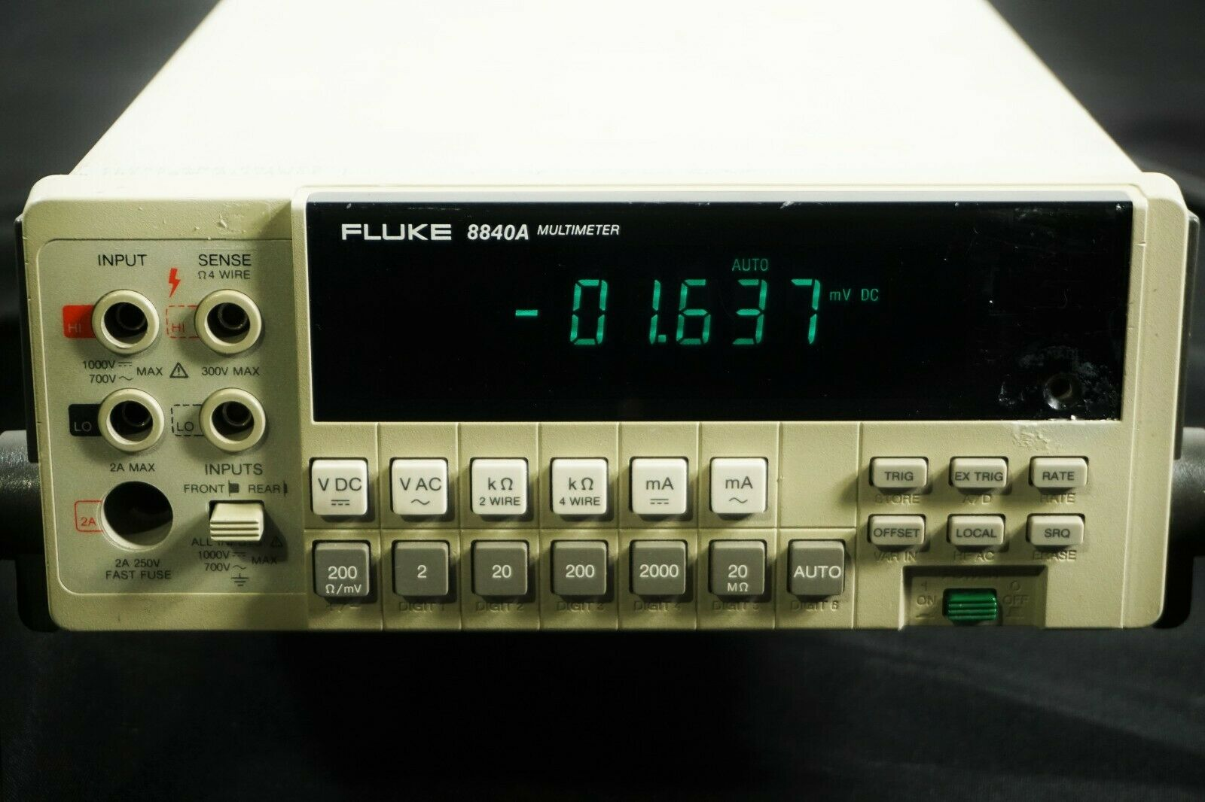
Fluke 8840A with 4 wire ohms
Cheap, stable and reads to .001ohm!

Slide 12
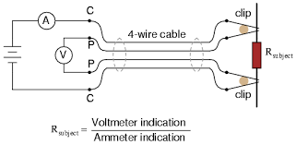
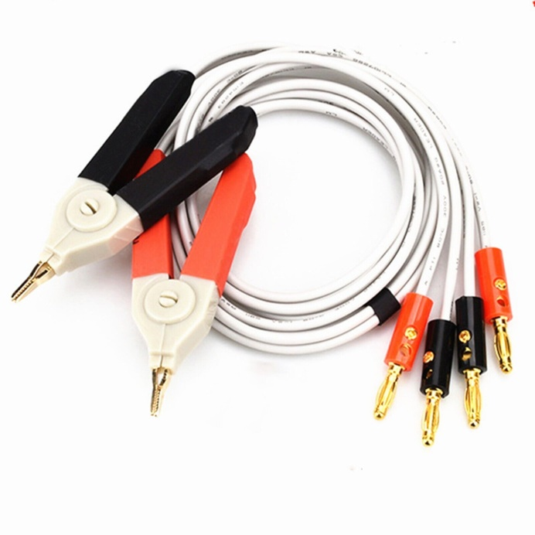
4 Wire Ohms Measurement
The technique extends
The internal circuit to
The outside.
Mainly for measurements below 1K ohms

Slide 13
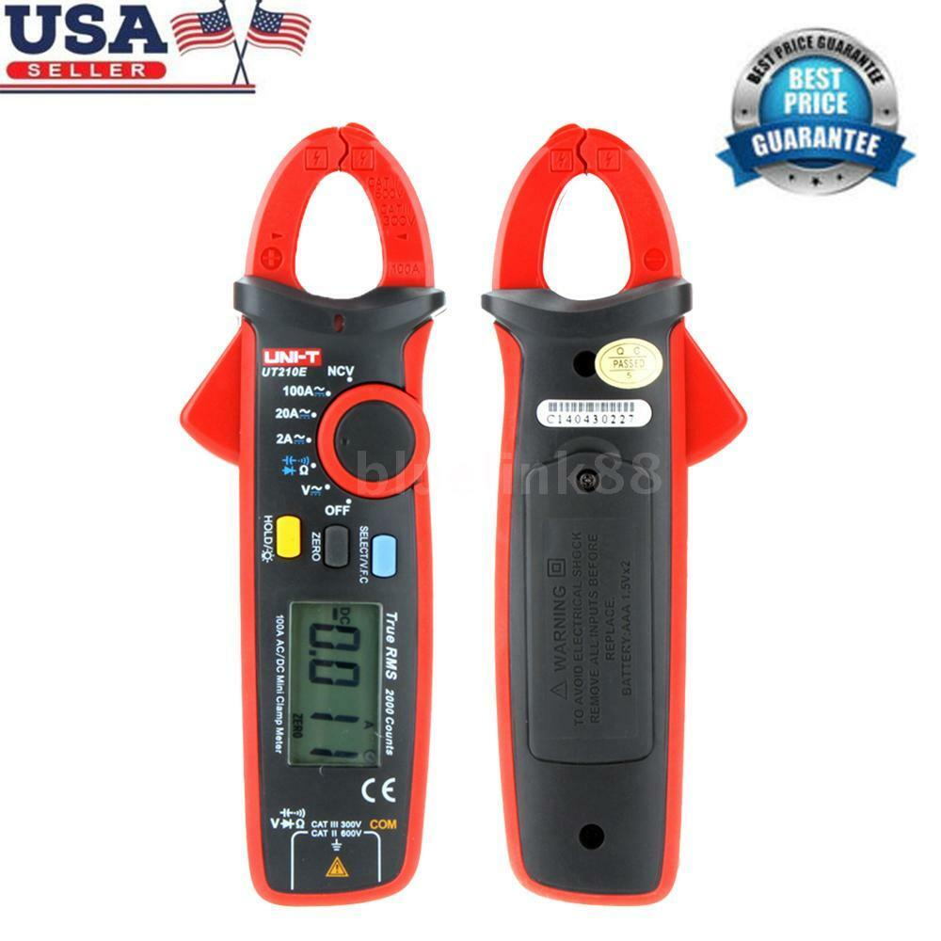
AC/DC clamp on ammeter UT210E
About
$45
Reads
Down to
1ma DC

Slide 14
Power Meter

Slide 15
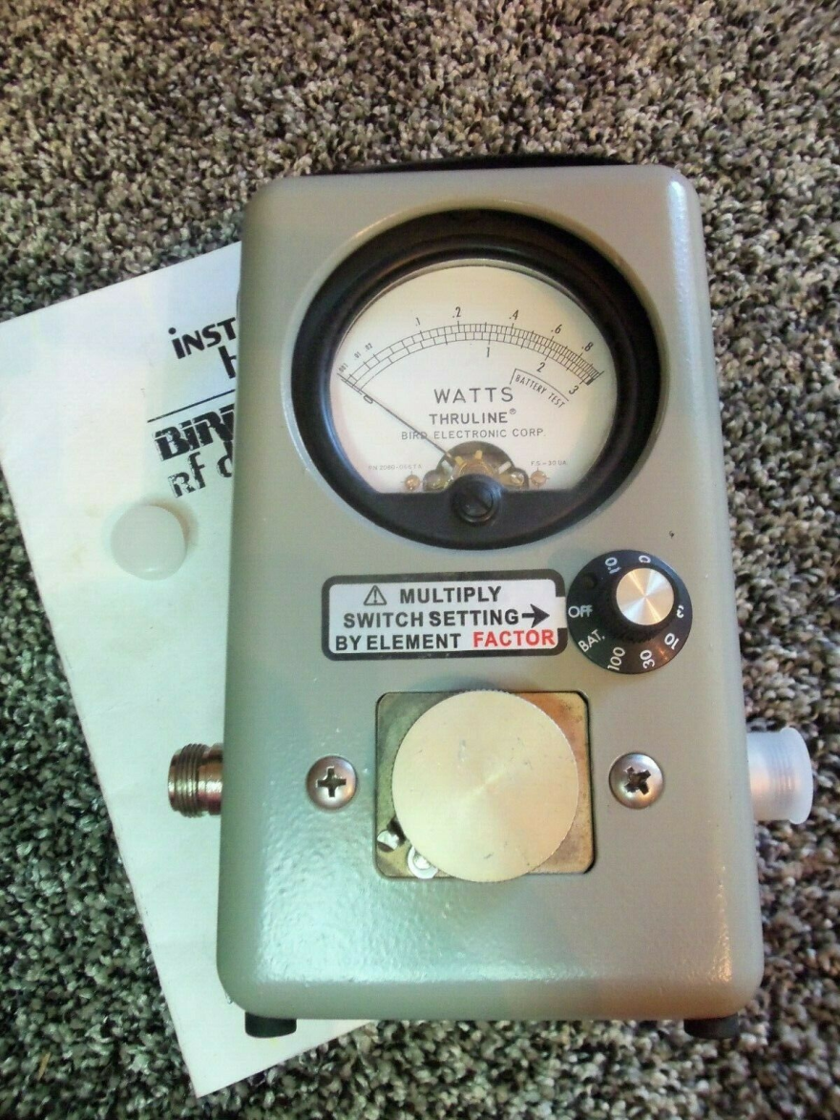
Power Meter Bird 4410A
Seven ranges
per element
5% of reading!
$300 with
elements

Slide 16
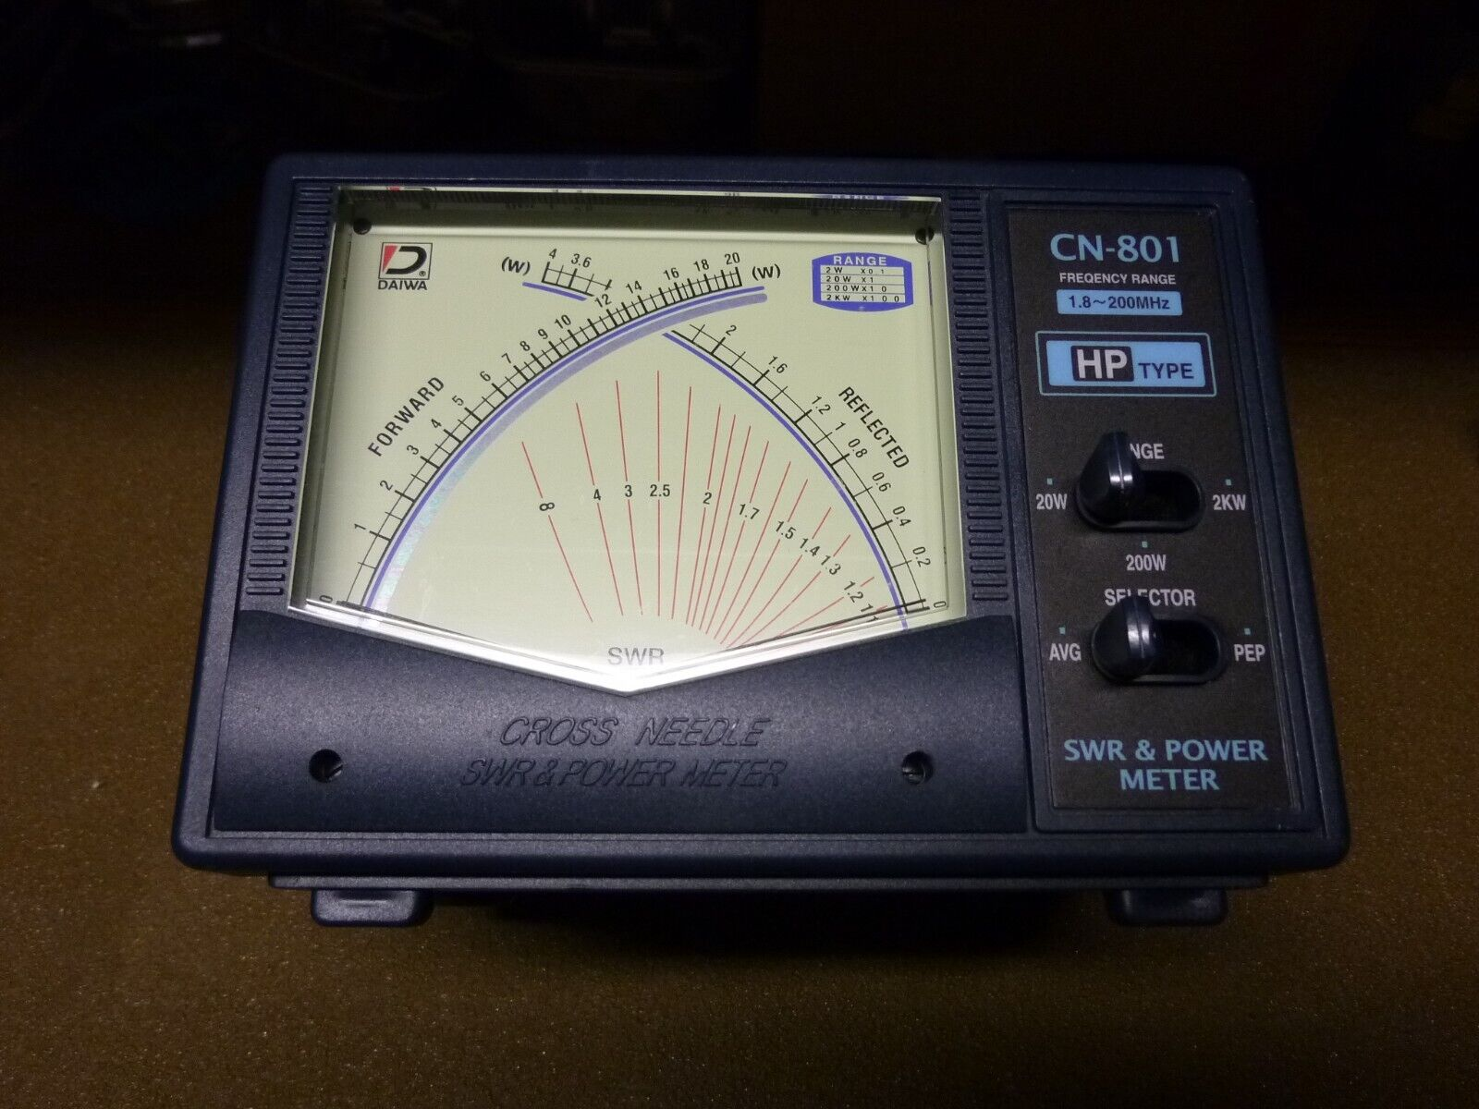
Daiwa CN801hp
$60

Slide 17
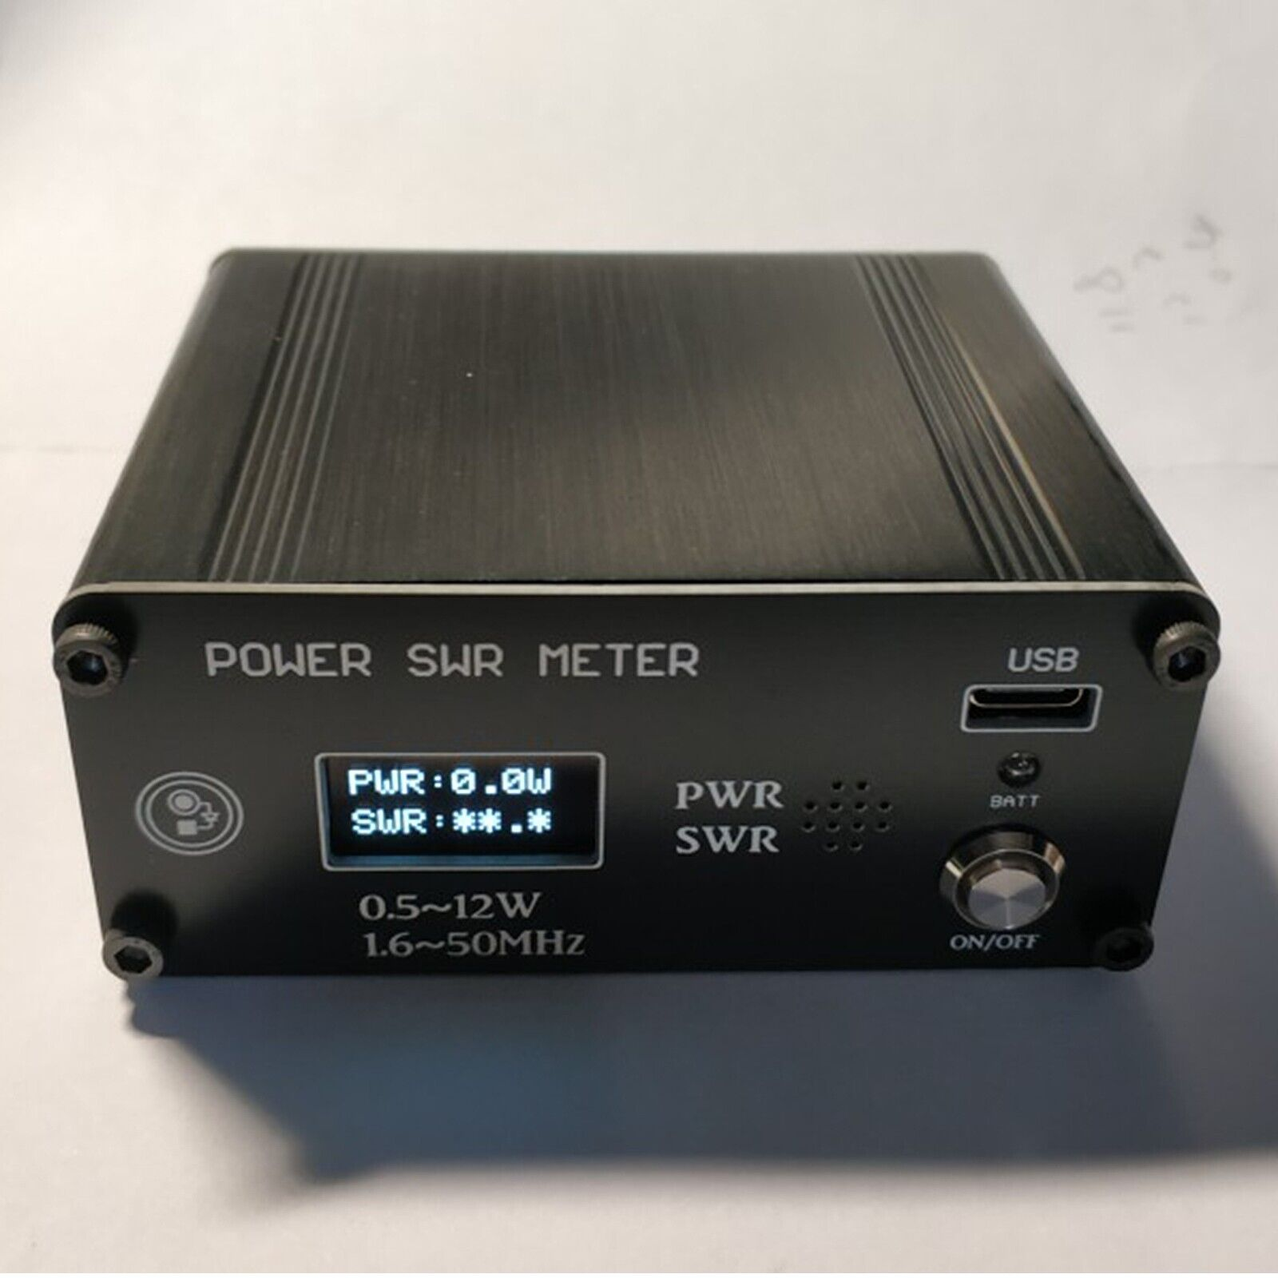
Newer Imported type.
Has battery
12 watts
And other
Ranges.
$50

Slide 18
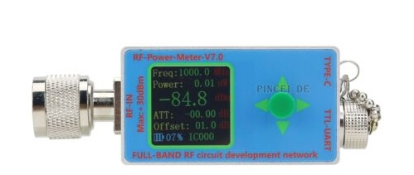
New Kid on the Block
N-Type RF Power Meter V7 10GHz
0-10Ghz
-60dbm- 1watt
Offset
Charges
through C
$85

Slide 19
Frequency Sources

Slide 20
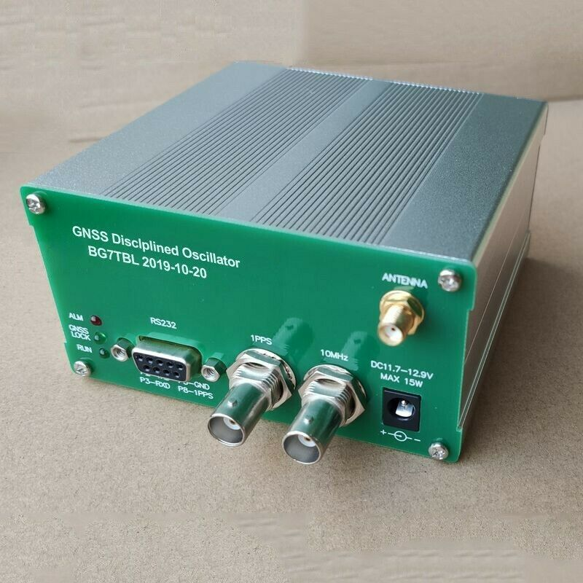
$150
GPS oscillator
10MHz output
Data output

Slide 21
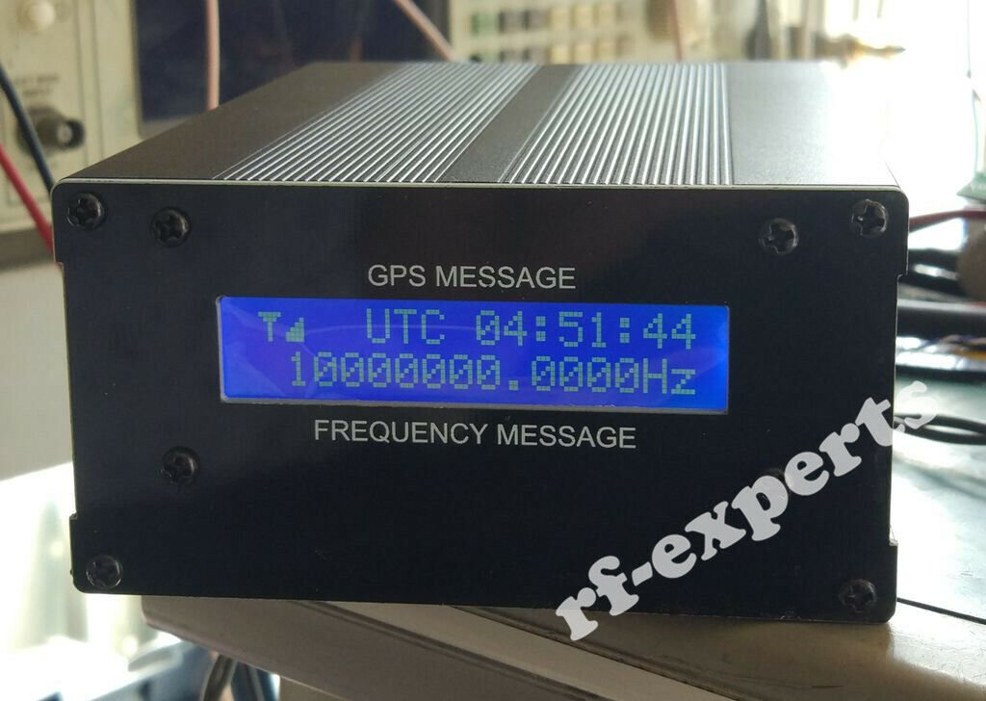
GPS Source with display
$190
Display shows
Actual Freq.

Slide 22
Signal Generators

Slide 23
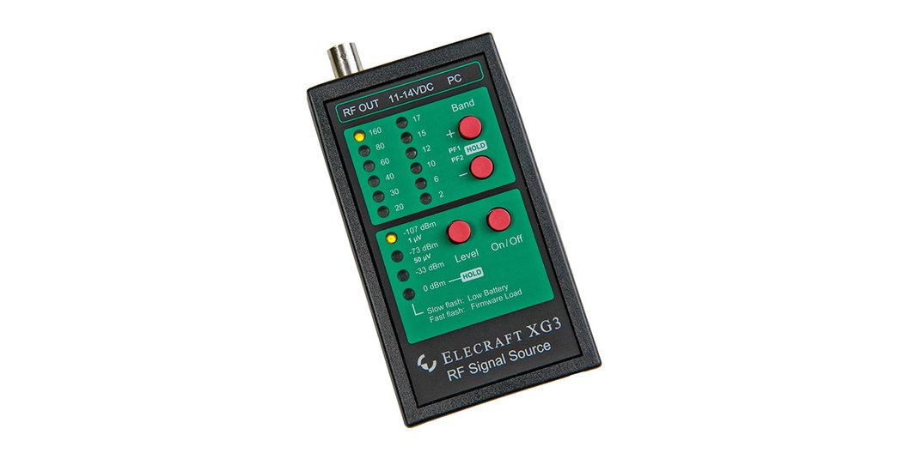
Elecraft XG3 Signal Generator
$260
Accurate versatile
Ham band oriented
Generator.

Slide 24
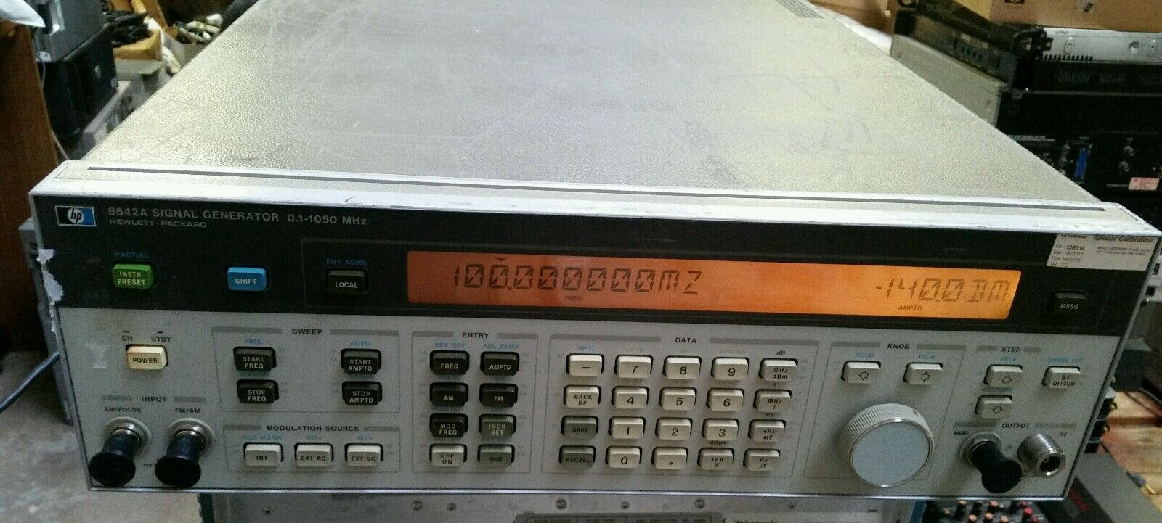
HP8642A/B
DC to 2GHz generator
$500
Nothing newer beats it for frequency and attenuation
(Be sure and change the fan!).

Slide 25
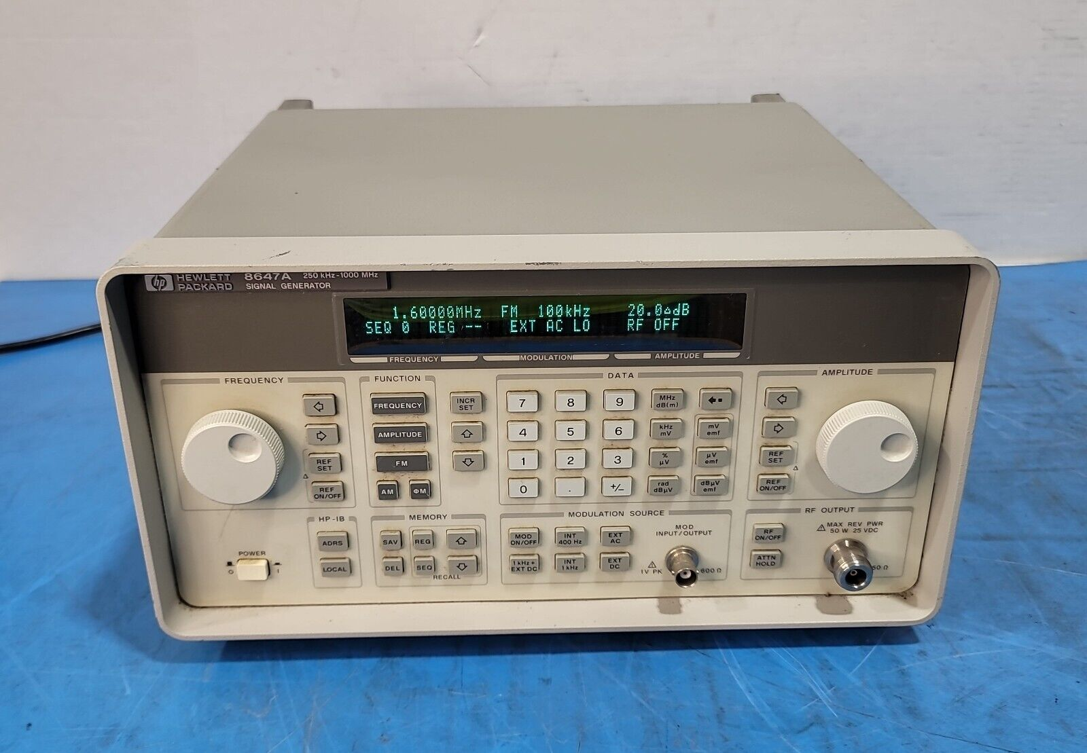
Agilent 8647/48 A-D

Slide 26
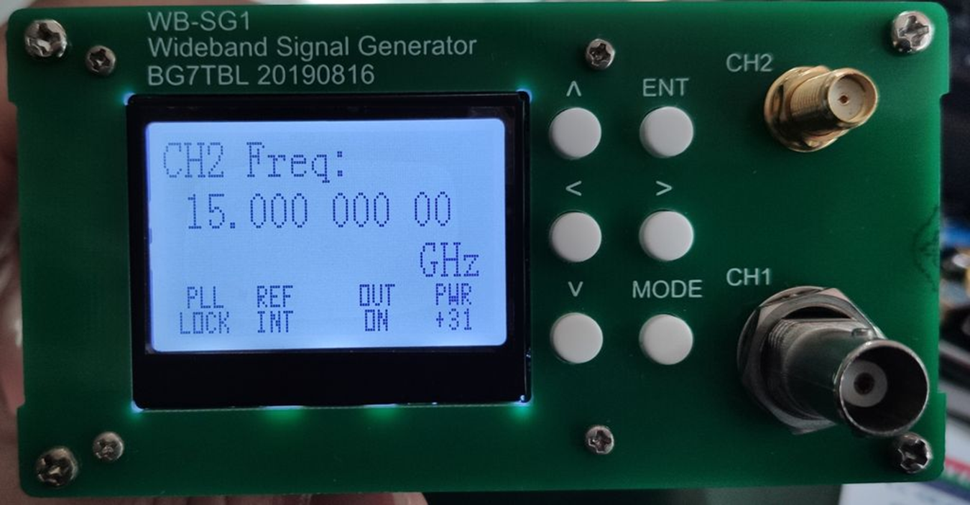
WB-SG1 $168
You will also need an external attenuator
$50-100

Slide 27
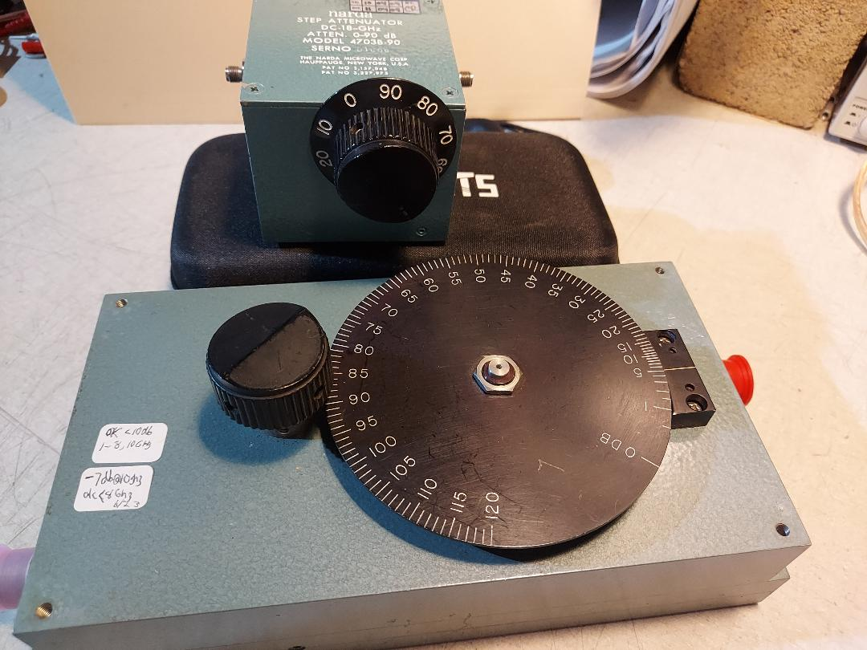
External Attenuators
Narda
Step Atten.
Narda
Variable
Atten.

Slide 28
Spectrum Analyzers

Slide 29
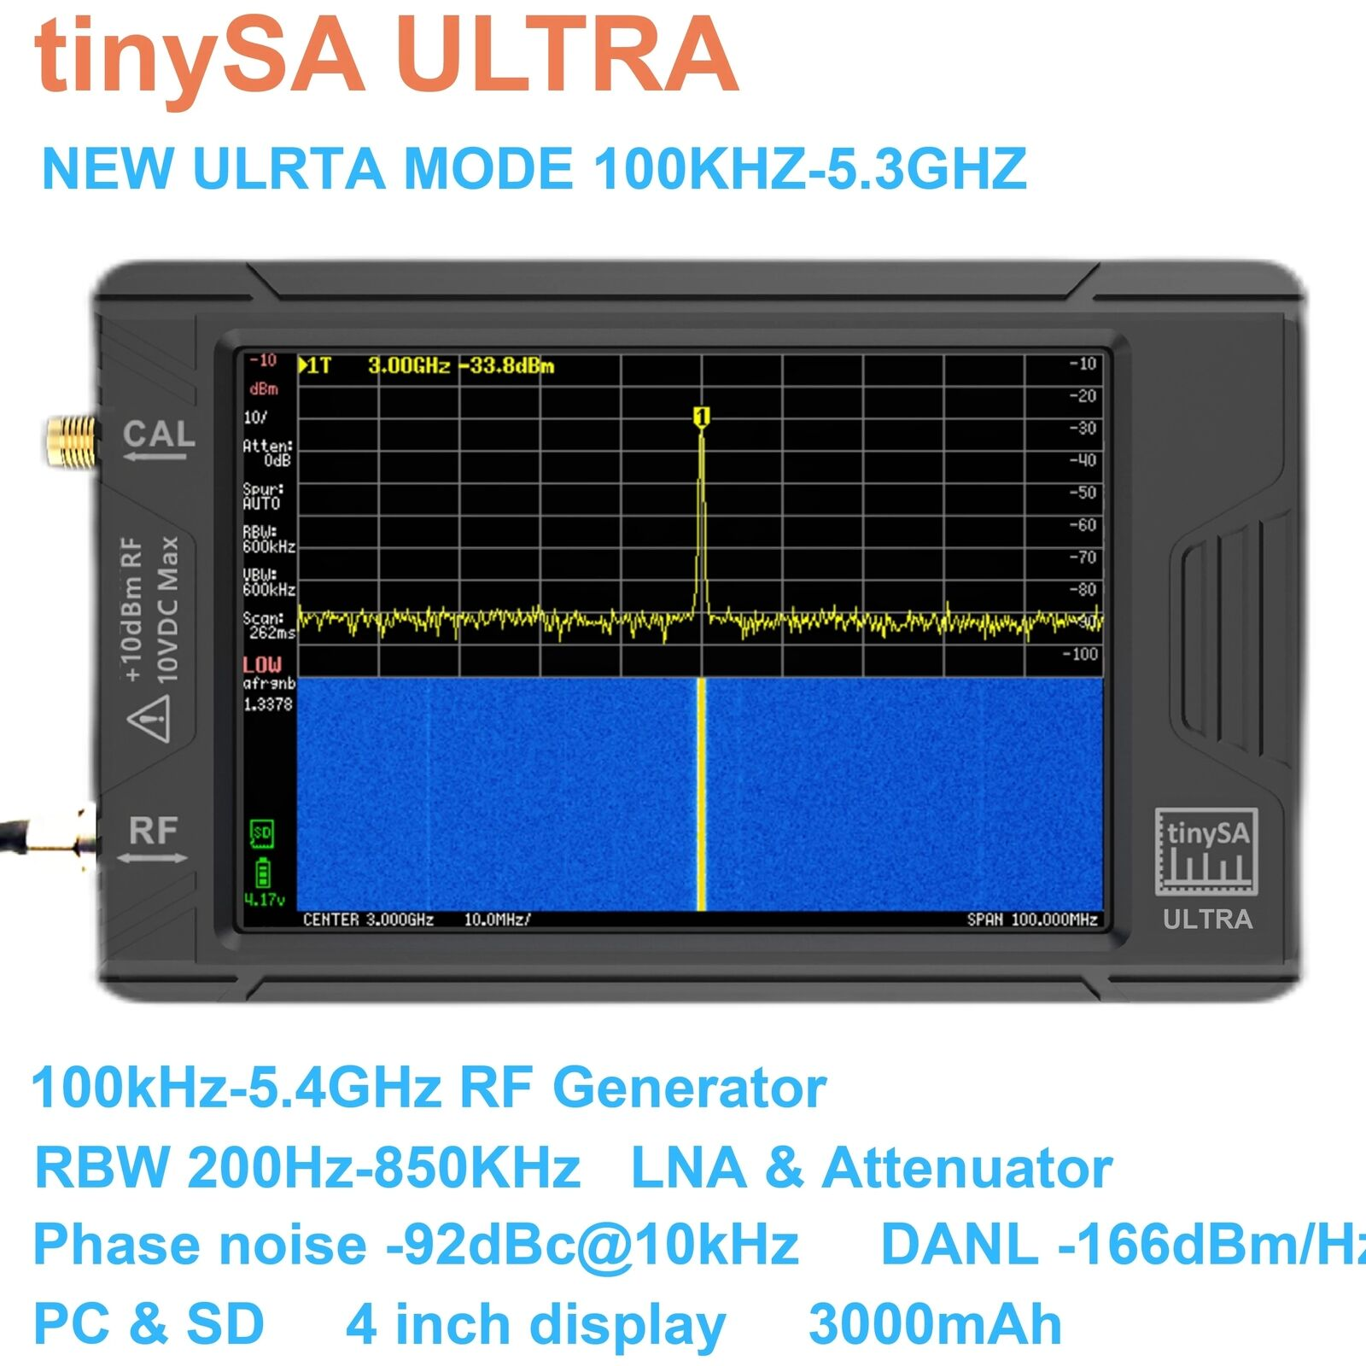
Tiny SA Ultra
Has 200hz
Resolution BW
Will go to 10GHz

Slide 30
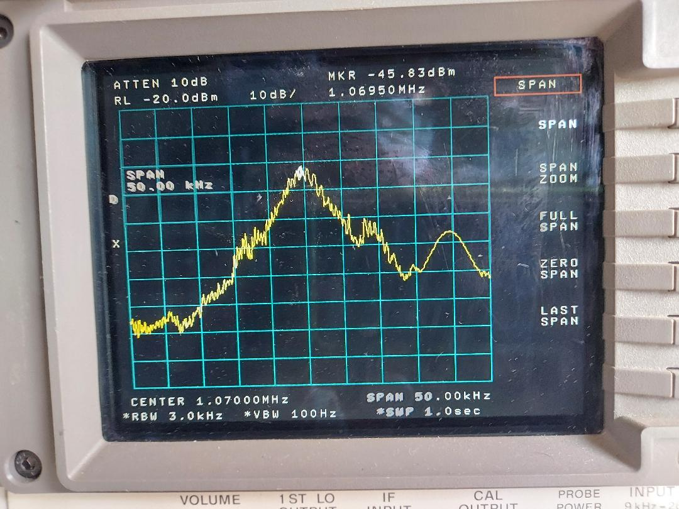
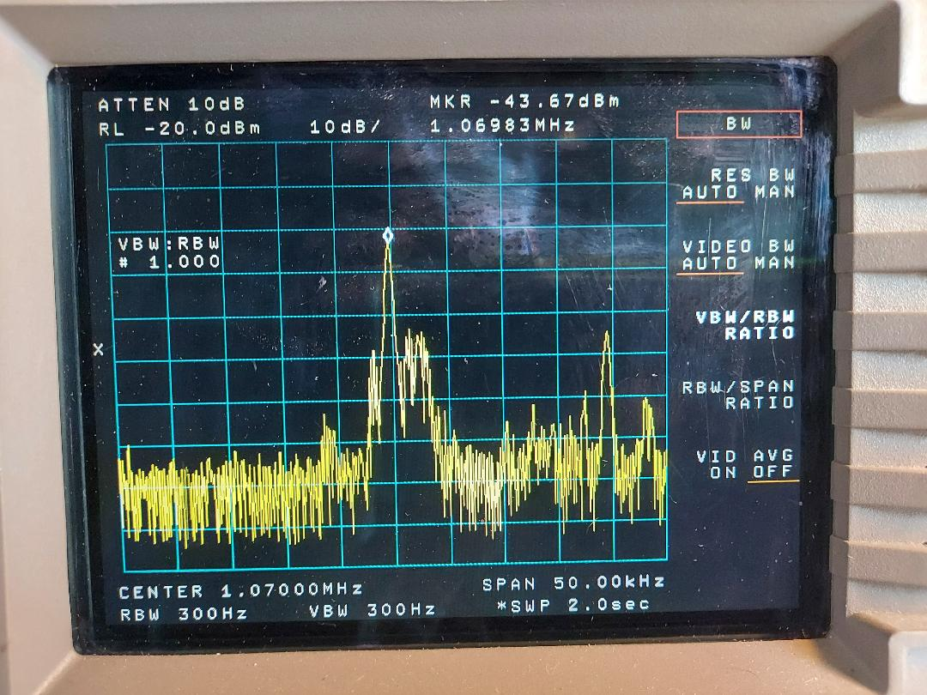
3KHz vs 300Hz RBW
KNX at 3KHz RBW
KNX at 300Hz RBW

Slide 31
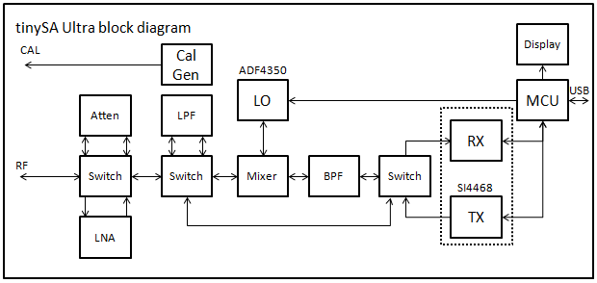
Block Diagram
1ST IF is 980MHz
2nd IF is 870KHz/SDR

Slide 32
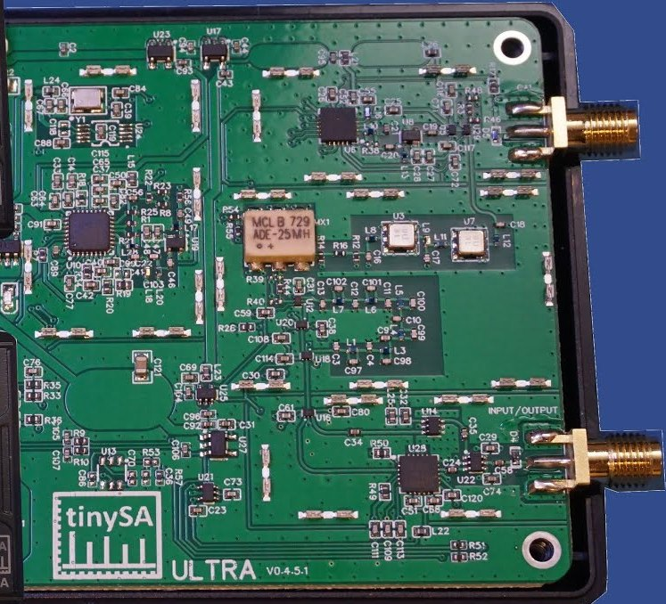
Tiny SA Ultra Inside
Generator output
Mixer, filters
Switched filter
Attenuator, LNA, Input

Slide 33
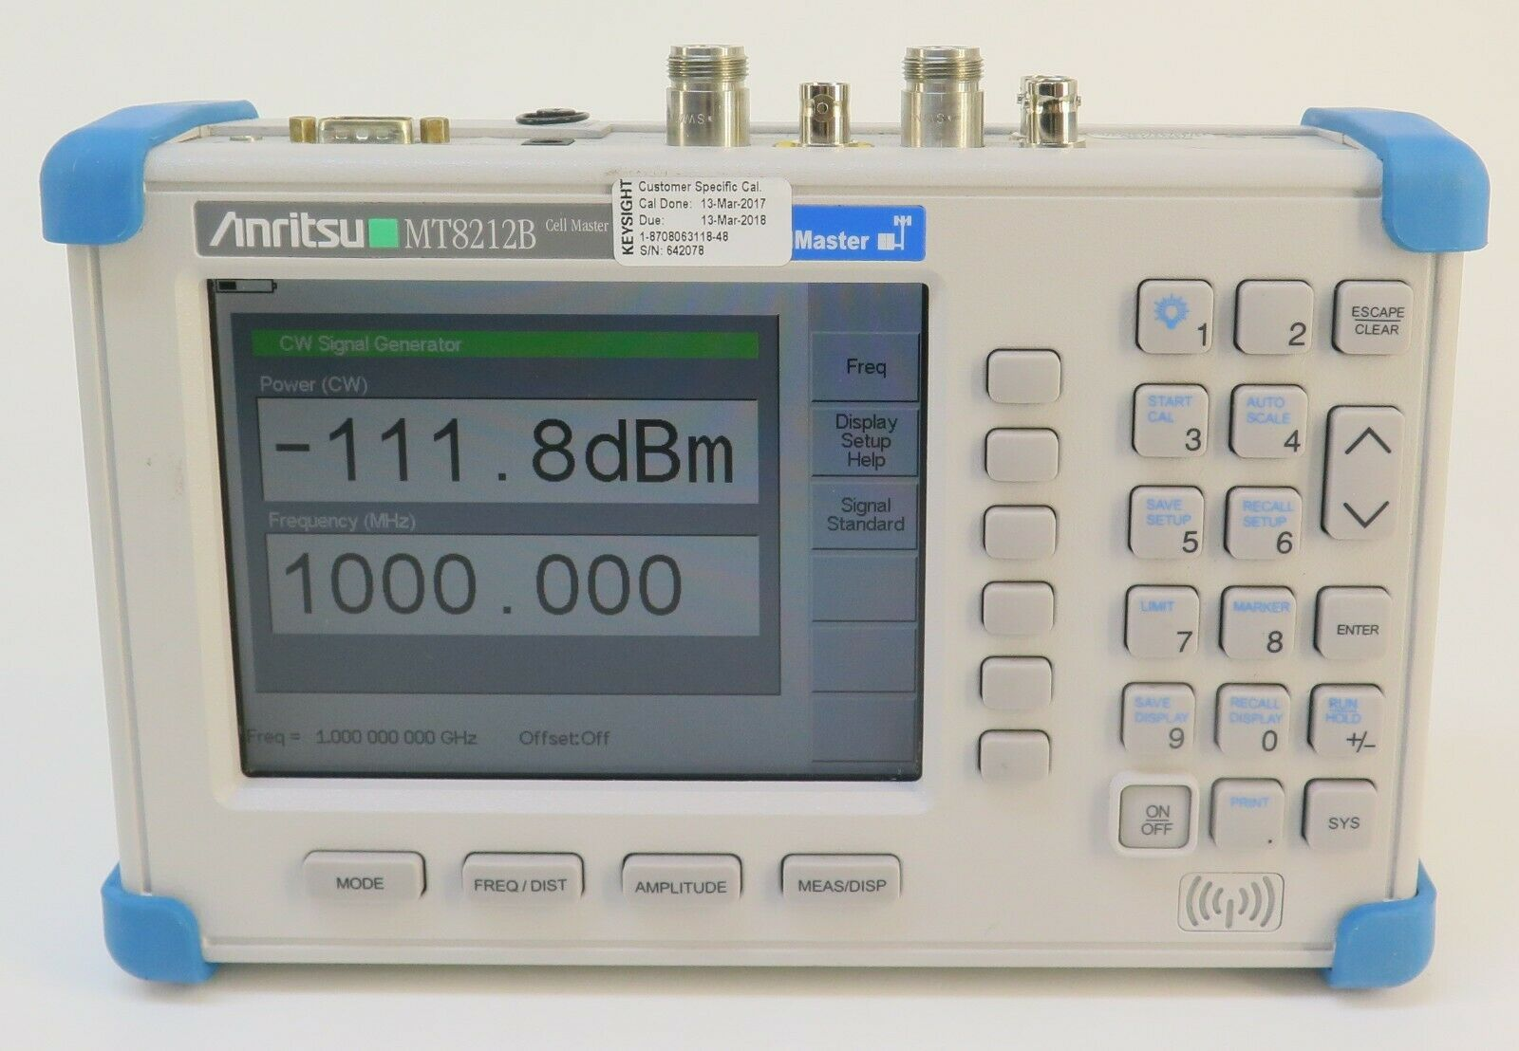
Anritsu MT8212B
$400-800
Best all in one deal-

Slide 34
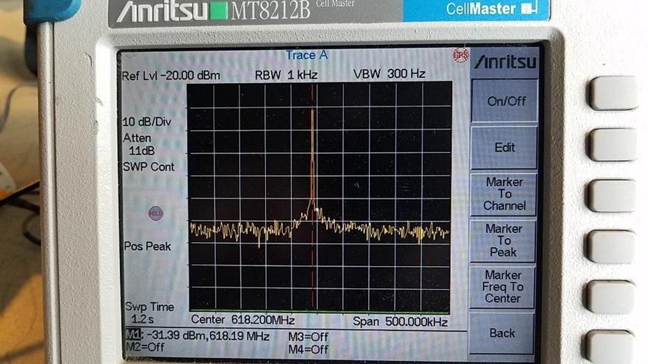
MT8212b Screen

Slide 35
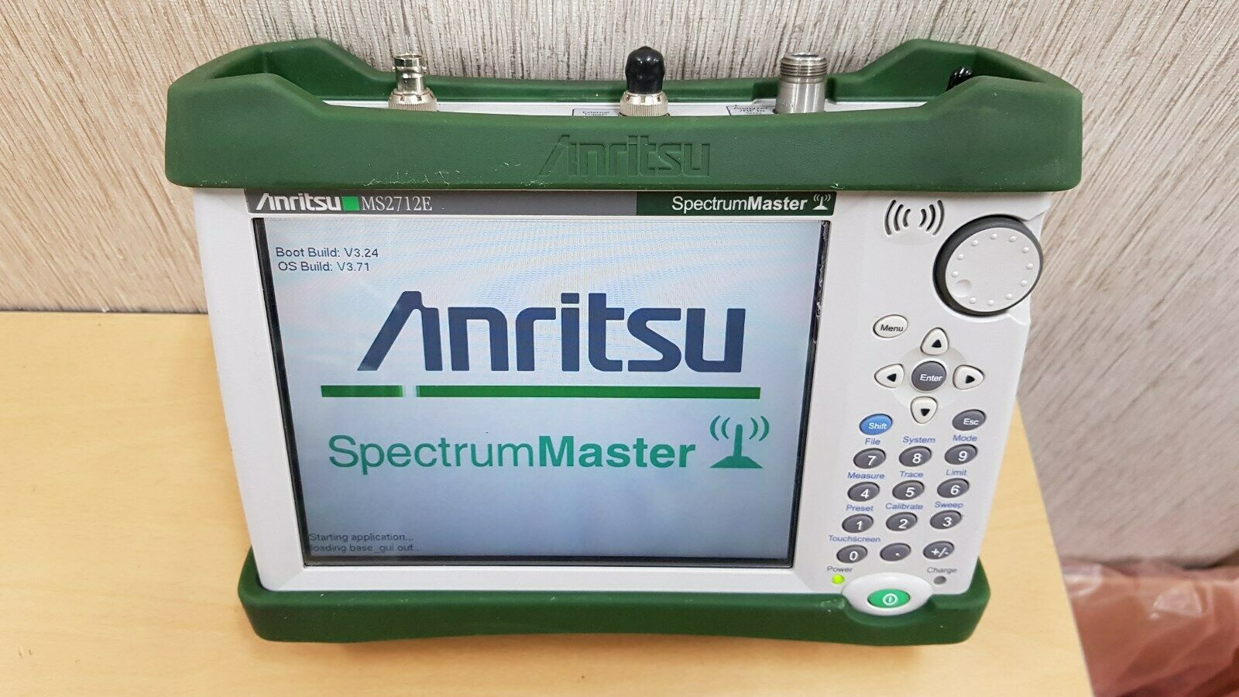
Anritsu MS2712E 9Kc to 4GHz
Battery operated, hand held, GPS frequency correction.
$1500
$1500

Slide 36
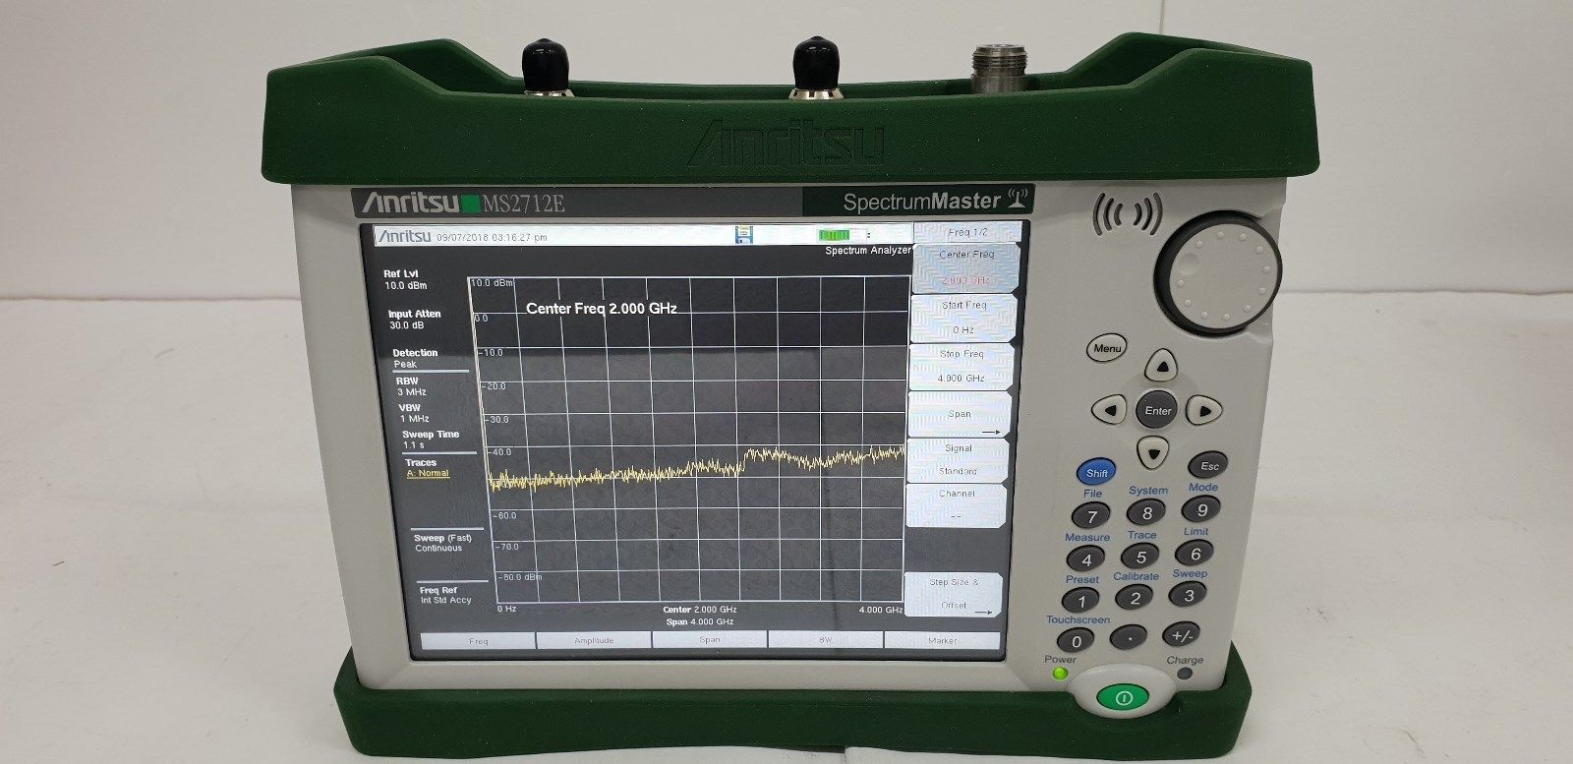
Anritsu m2712E Screen

Slide 37
Oscilloscope
You want one with auto set
Analogue like display- 256 levels of intensity

Slide 38

Excellent
100MHz scope <$100

Slide 39
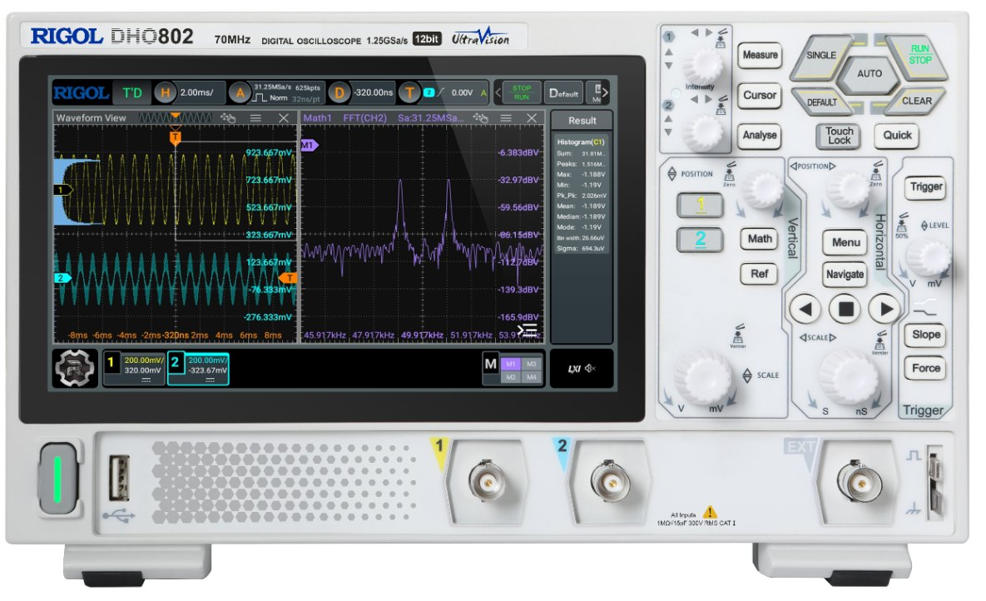
Rigol DHO802
70MHz- $299 USB c
Touchscreen, HDMI, 2” Thick!

Slide 40
Counter

Slide 41
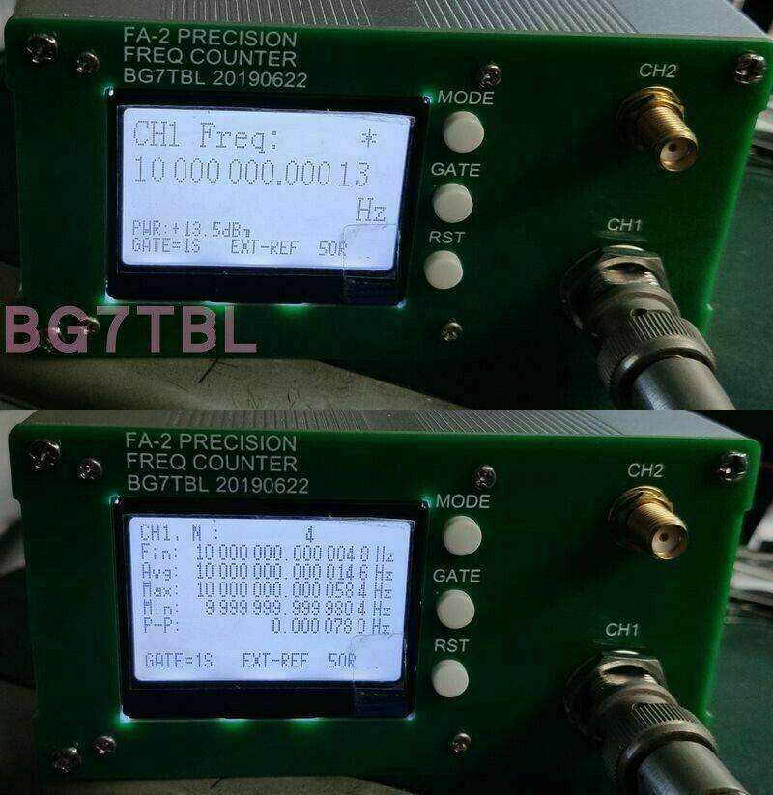
Frequency
Counter
$115
13 digits
0-6GHz

Slide 42
Miscellaneous

Slide 43
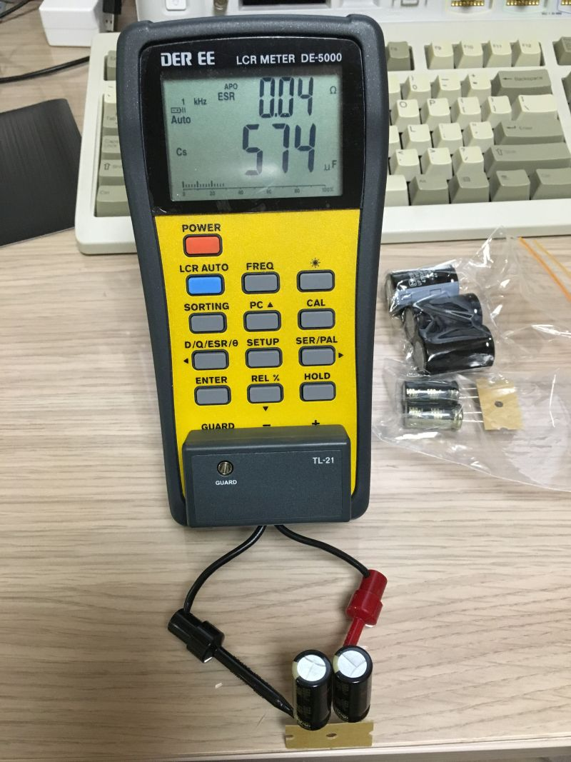
LCR Meter DE 5000
LCR meter
ESR measurement
.01 ohm resolution
Less than $80

Slide 44
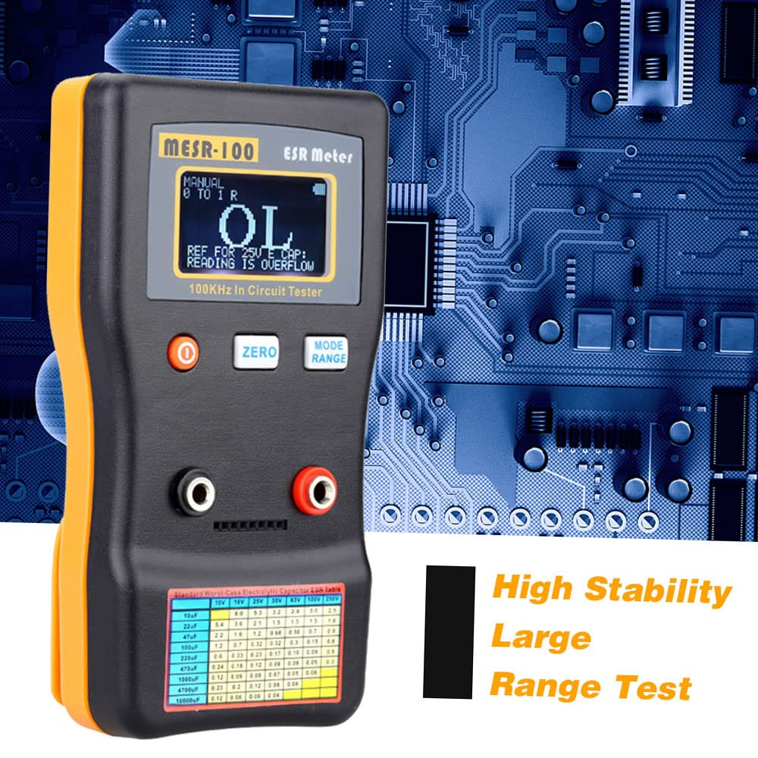
MESR 100 v2 ESR Meter
Very good quality
It tells you what to do.
About $50

Slide 45
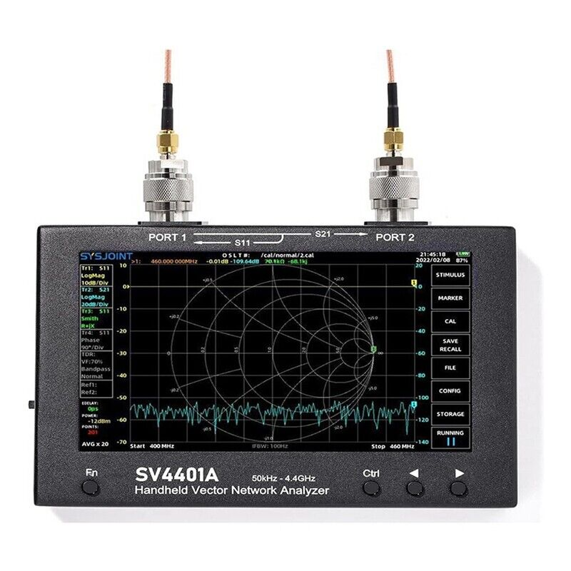
SV34401 VNA
50KHz-4.4GHz
100db Dynamic Range
Full featured
Does TDR
$300

Slide 46
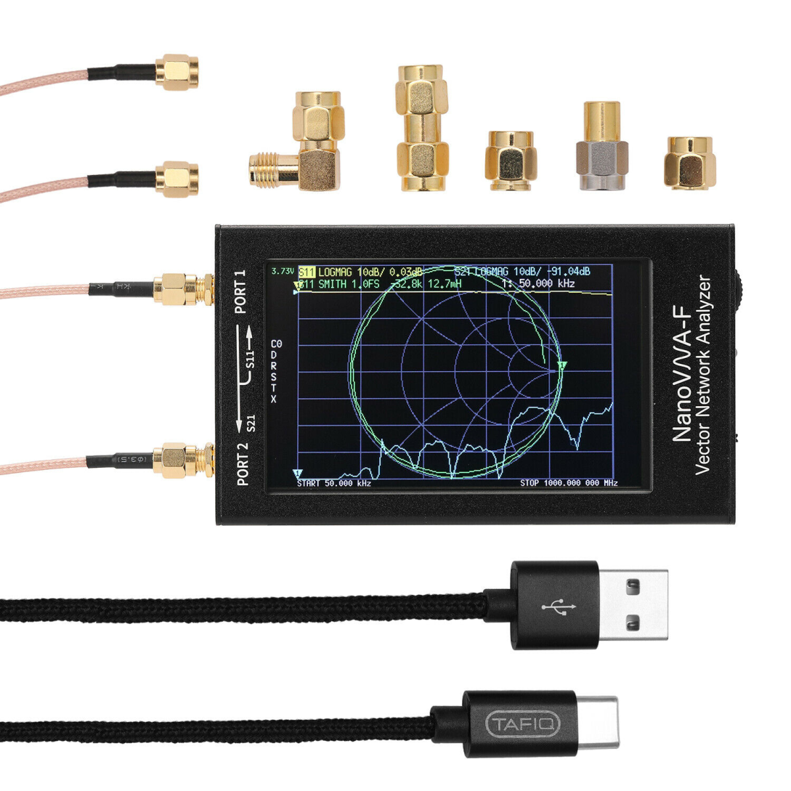
NanoVNA-F
Double check the calibration load
$120

Slide 47
Resistance vs. Return Loss
Resistance SWR Return Loss
50.5 ohms 1.01 46db
51.0 1.02 40
51.5 1.03 36
52.0 1.04 34
52.5 1.05 32

Slide 48
Resistance Measurements of a Group Of 21 SMA 50 Ohm Loads
50.41
50.017 (M1408)
49.89
49.5
50.22
49.85
50.22
51.16
50.12
50.67
48.19
49.87
50.35
50.20
50.15
All below are 26.5GHz+
50.058 HP909d
50.080 Anritsu 40Ghz
50.040 Anritsu 40GHz
50.070 Winchel 40GHz
50.012 Anritsu 28V50 65GHz
50.264 HP85138 50GHz

Slide 49
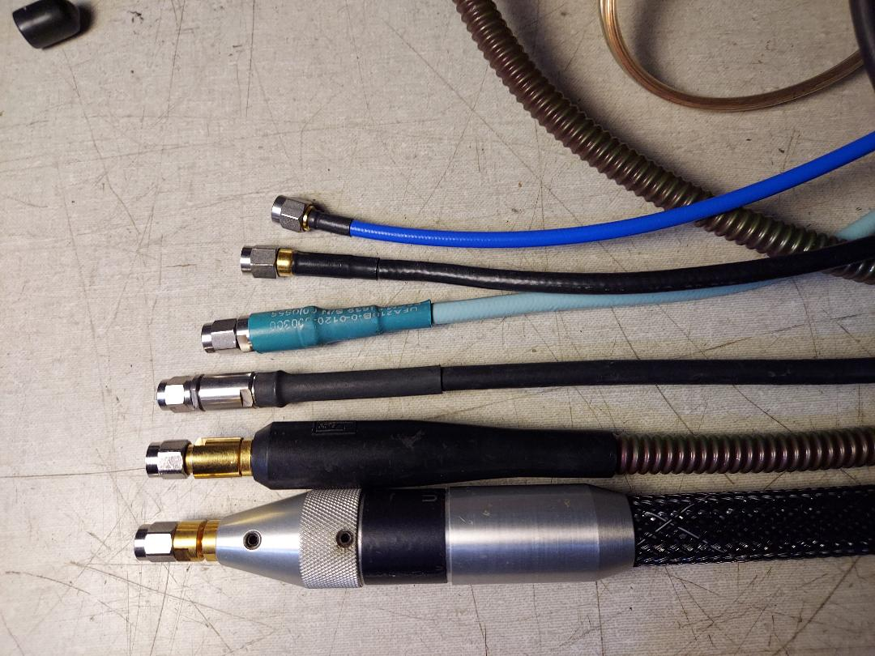
Notice the difference in Strain relief
Cable shield and dielectric
To connector interface is the
problem.. Strain releif
Utiflex

Slide 50
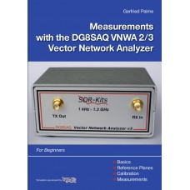
VNA Resources
From SDR-Kits $35
User’s Manual
HP 8720B VNA
(Download a PDF)

Slide 51
Calibrators

Slide 52
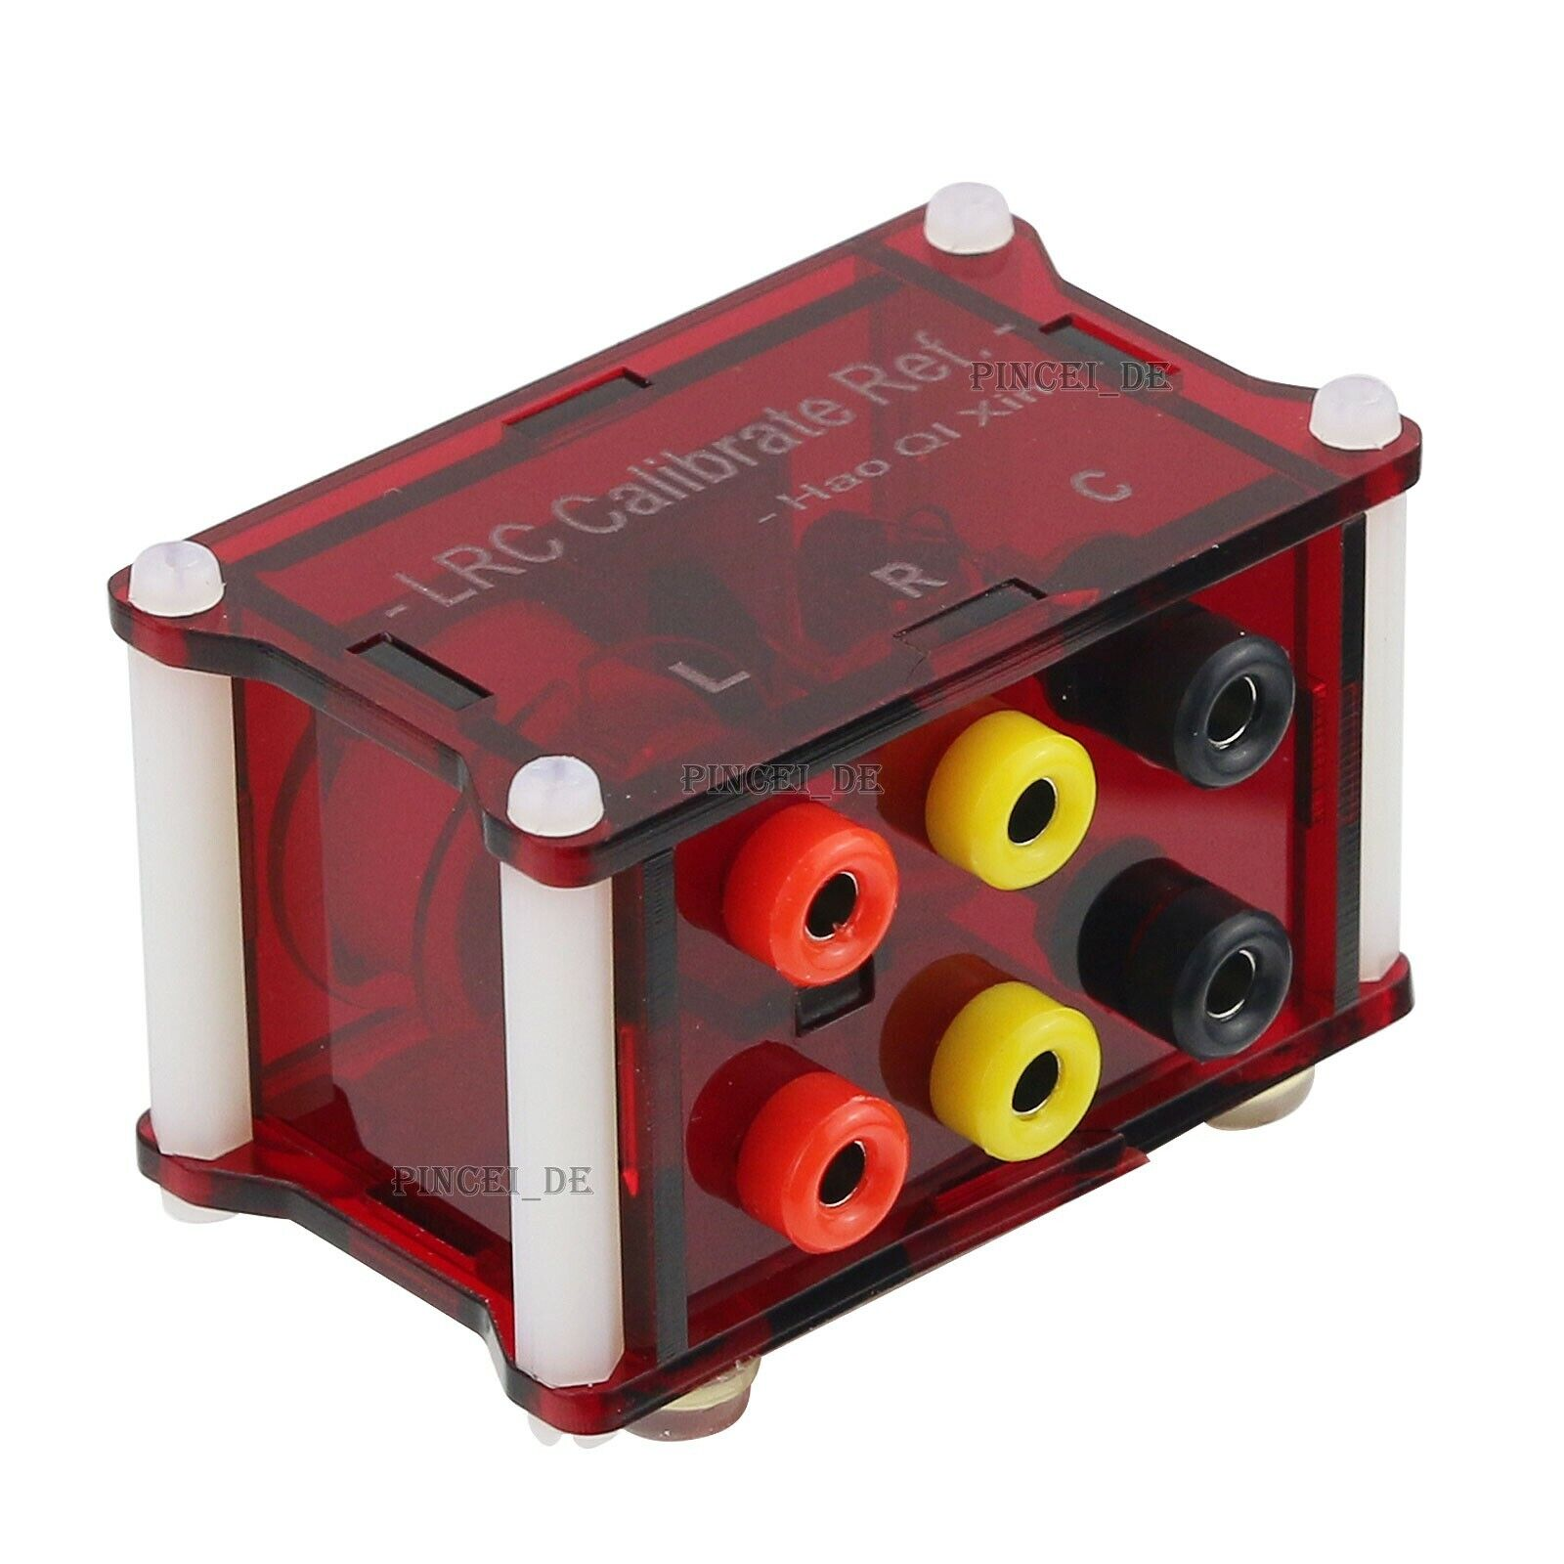
RCL Box
Handy calibration tool and cheap
Resistance
Capacitance
Inductance
EBay- “High Precision
Inductance Resistor Capacitor
LRC Calibrate Reference Module Box”
. Calibration to 5 digits. or so.
About $25

Slide 53
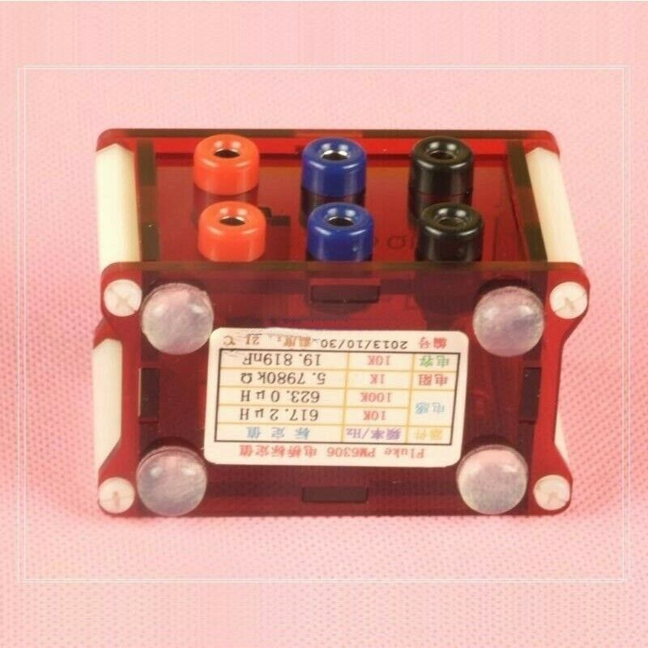
RCL Box Cal Data
617.2uh @10KHz
623.0uh@100KHZ
5.7980 Ohms
19.819nf@10KHz
plus cal. date

Slide 54
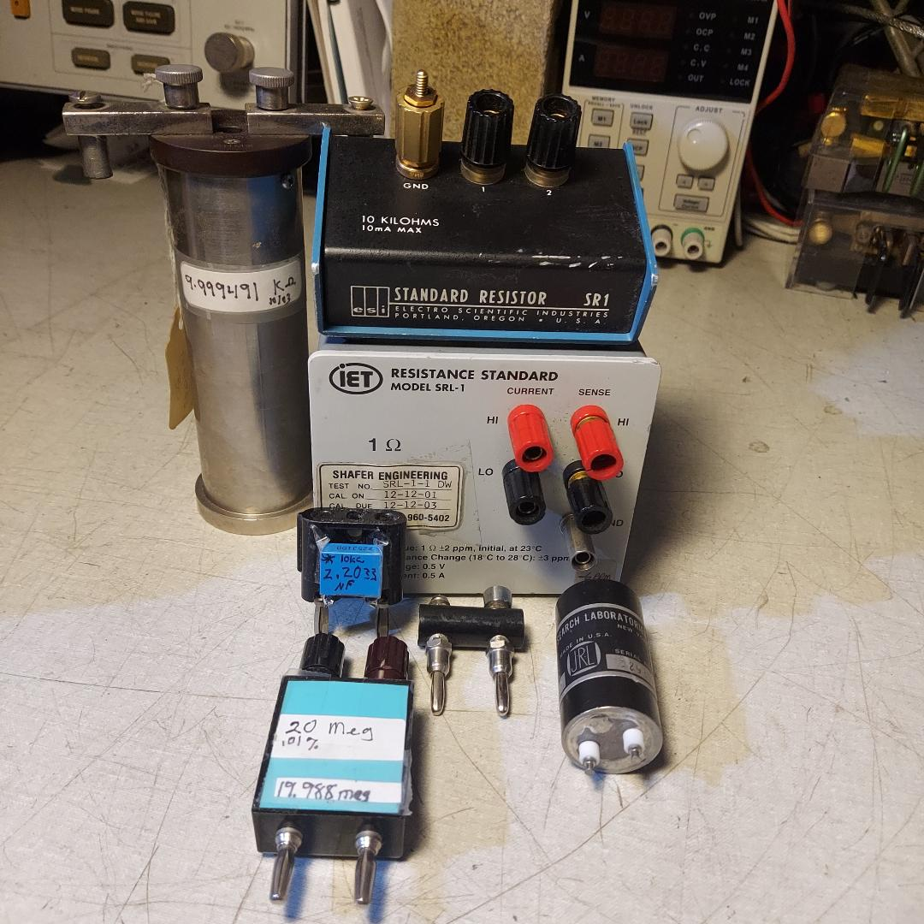
Find yourself a resistance standard
That is labeled
Honeywell
Check for
ESI SR-1

Slide 55
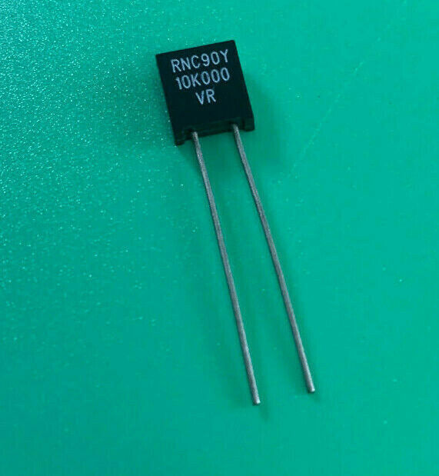
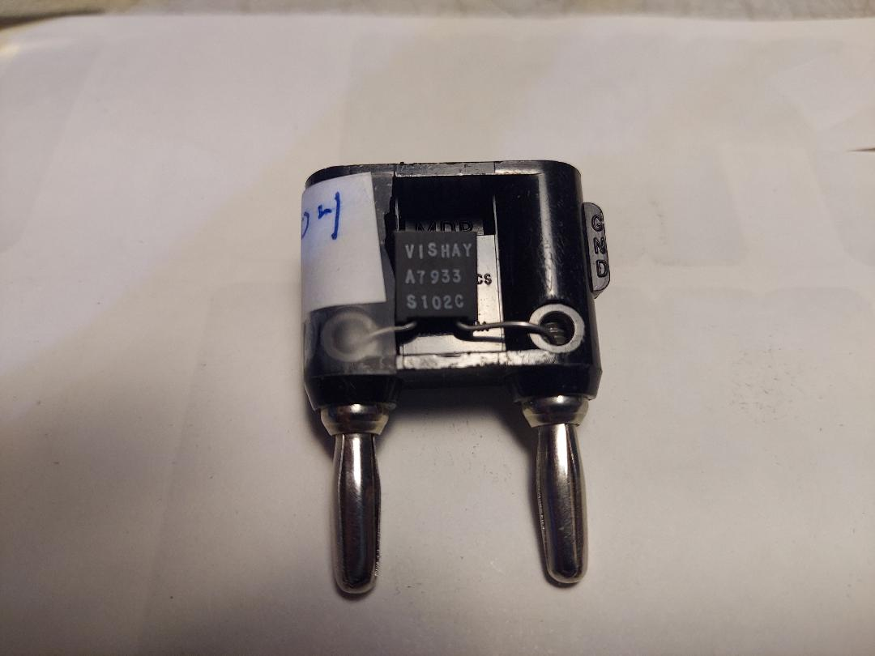
Make your Own
You need a good resistor and a two pin banana plug
.005% at 10K ohm (VR marking)
Vishay RNC90Y10K000VR
$10 on EBay

Slide 56
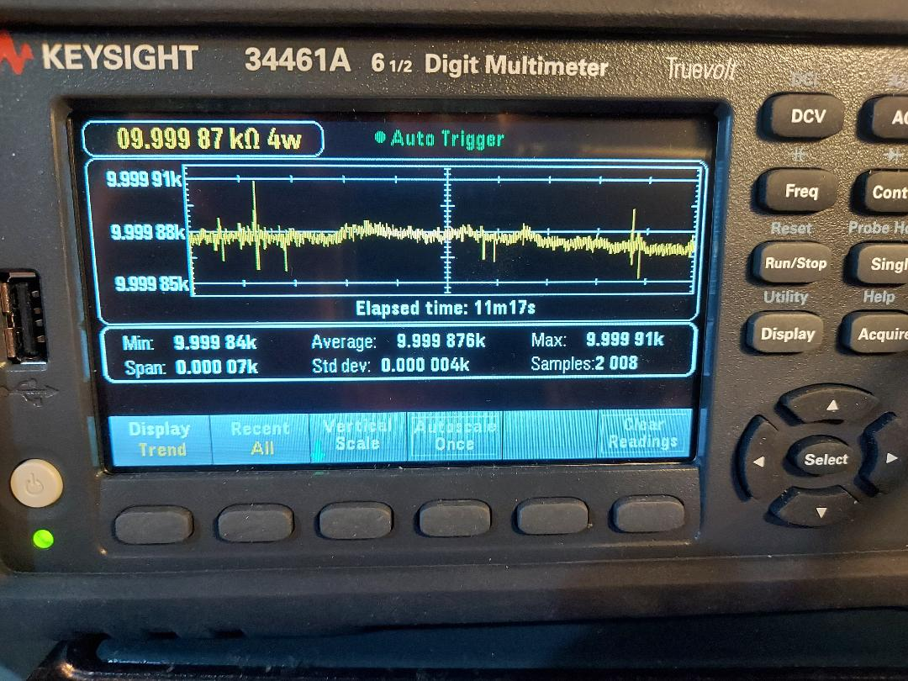
Calibration Data

Slide 57
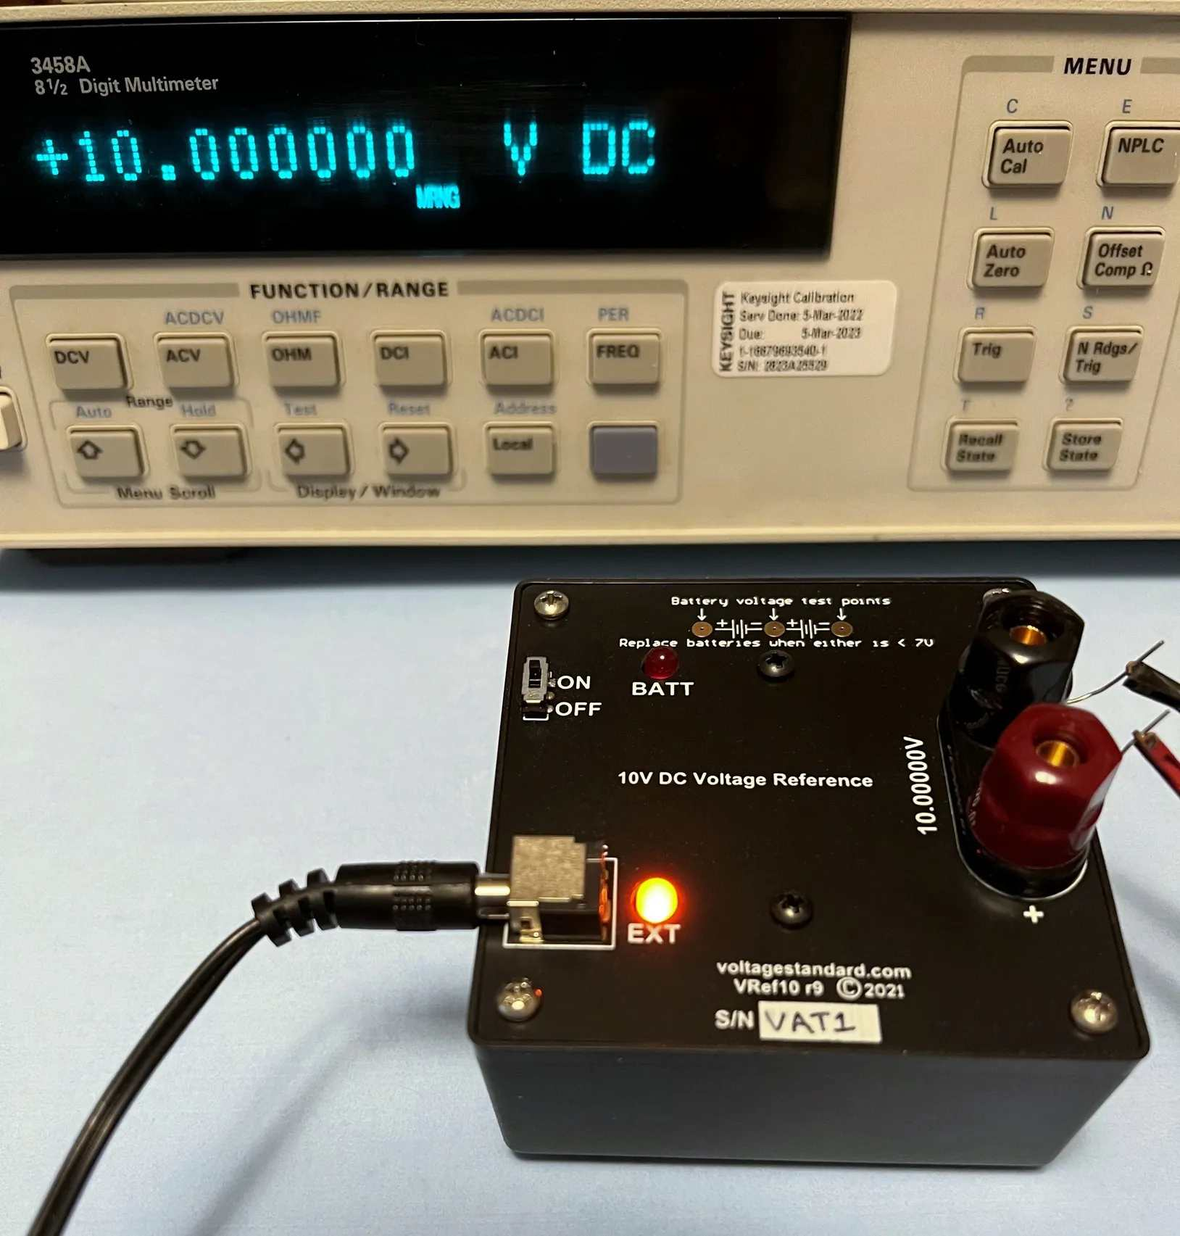
Voltage Source
Lab quality
Comes with cal. data
at $160
From
“Voltagestandard.com”

Slide 58
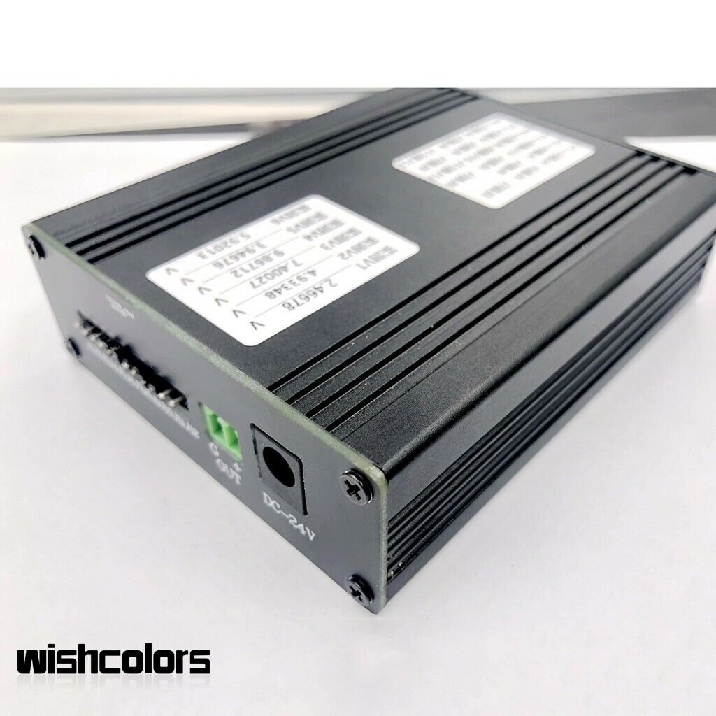
Cheaper- 4 Output
$60 with PS
Has Cal Data (6 digits)
Very stable
LM399.
Well designed
Mine- 10.233214 v
Listing-
LM399 Power
Reference Module

Slide 59
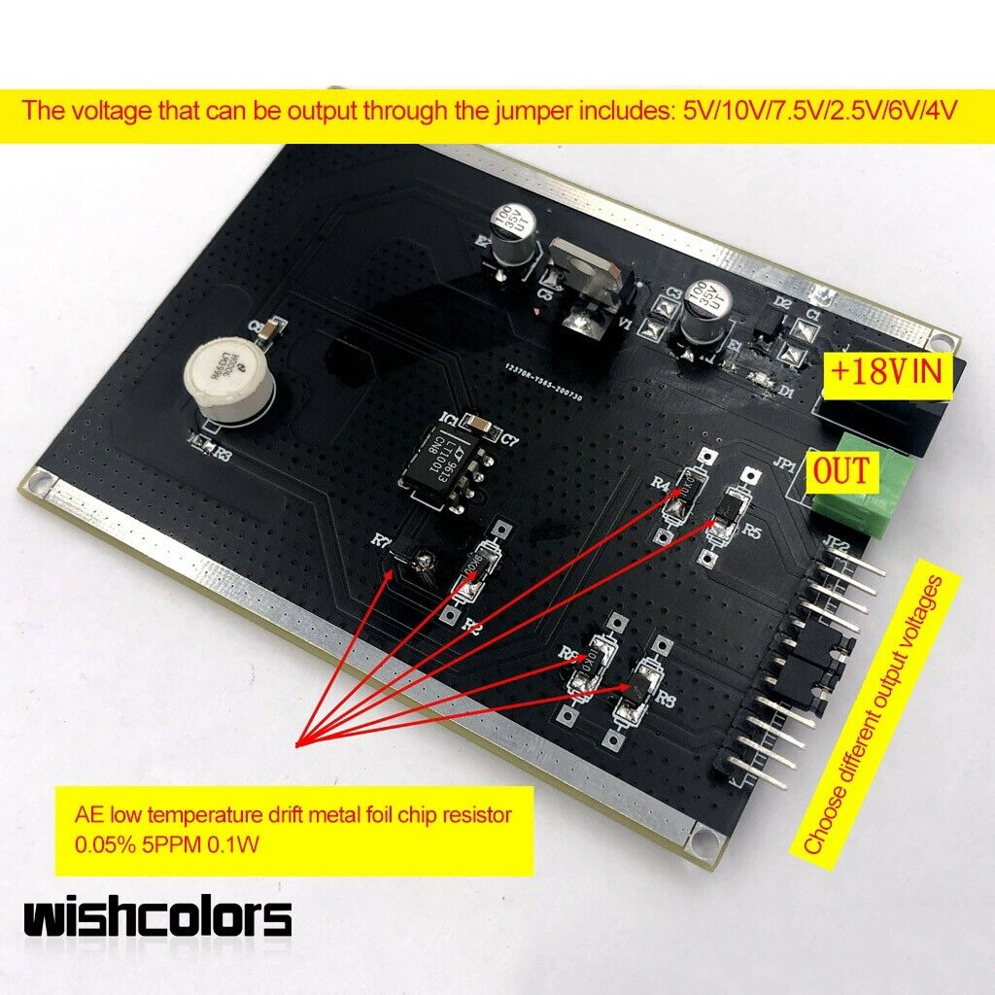
Good Design
Regulator is
insulated
Isolated
Power supply well
regulated
Good Temp co
resistors

Slide 60
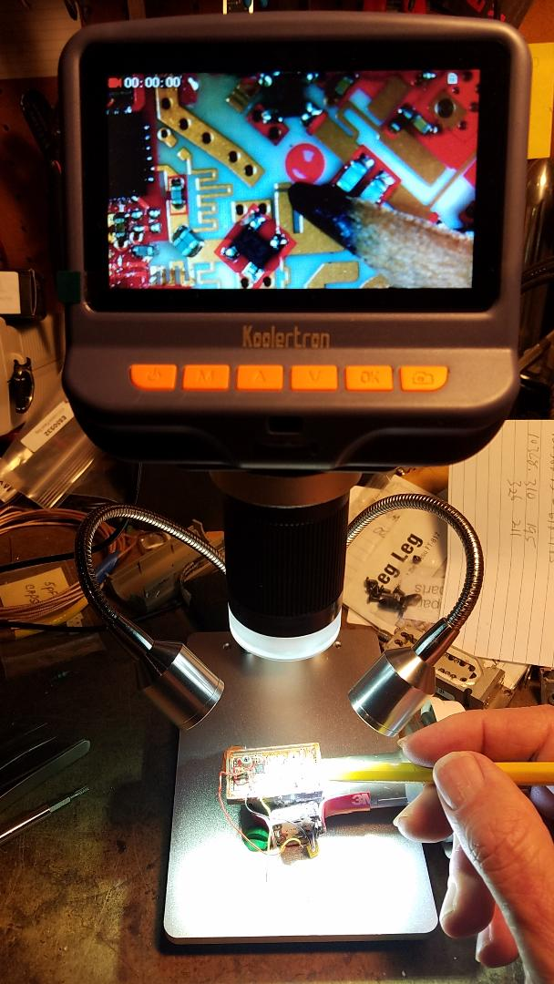
Save your eyes, do better work
Koolertron 4.3” screen
$70

Slide 61
Contact Info
drzarkof56@yahoo.com

Slide 62
That’s it. Any questions?

